Slide 1
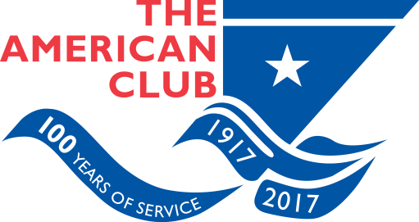
Back to the Future on an Excellent Adventure P&I embraces the Digital Age
Tom Hamilton (‘06)
Chief Underwriting Officer
Shipowners Claims Bureau, Inc., Managers
American P&I Club
New York

Slide 2
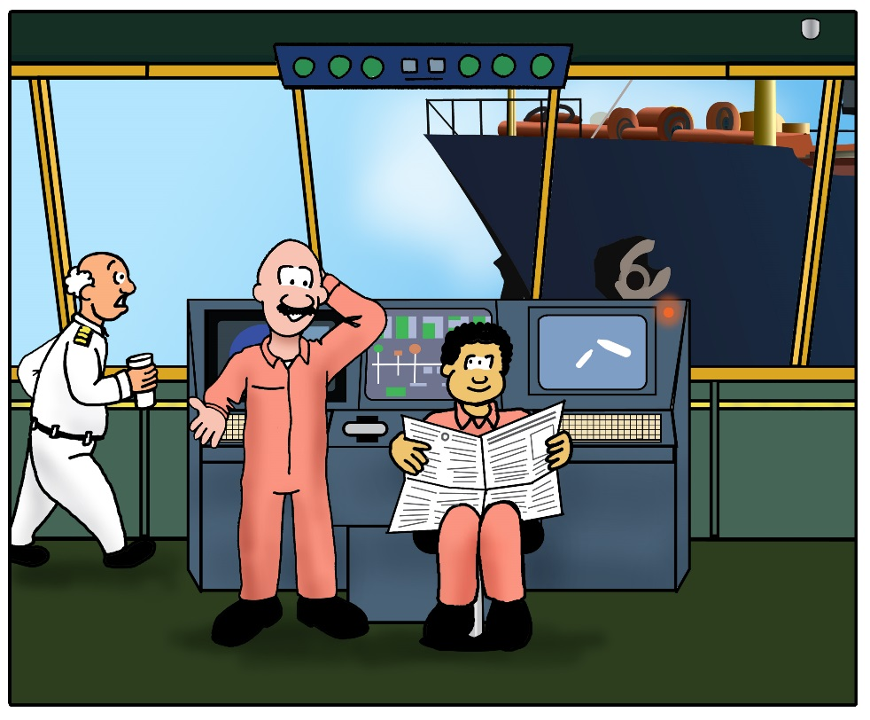
Summary
Brief History of Marine Insurance
International Group of P&I clubs
American P&I Club
What is “P&I”
Digitalization & the Future
For P&I clubs
For You

Slide 3
Quick Ride in Our DeLorean
The beginning…Turn Your Watches Back to 2100….BC
Babylonian merchants – The Code of Hammurabi
Risk transfer against loss of cargo based on value of ship
The Second Beginning…Reset Watches to 1200 BC…
Phoenicians, Indians and Greeks
General Average – common sacrifice shared
The Modern Beginning…London 1700 AD!
Edward Lloyd’s Coffee House
Meeting place for shipping industry
Maritime insurance featured
Genesis of ‘Lloyd’s of London’

Slide 4
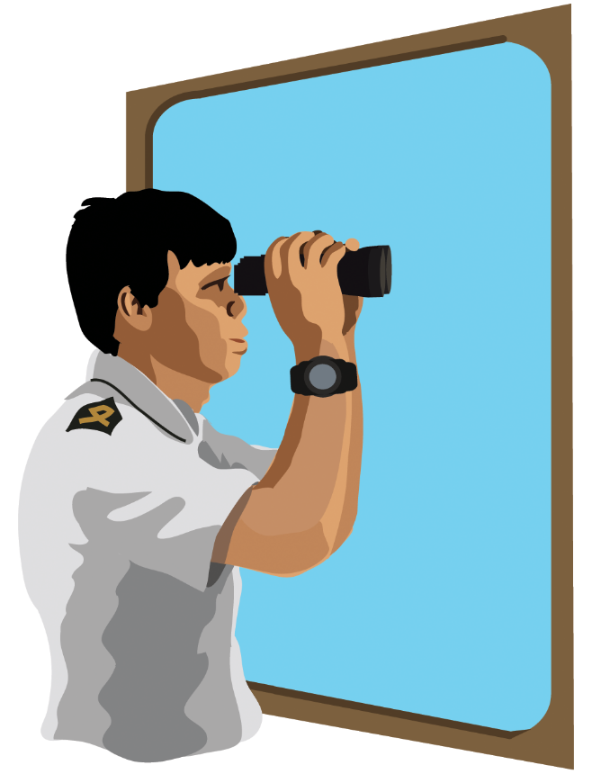
What happened in 1855?
Legend tells us marine (hull) insurers would not offer cover for the legal liability of an insured ship in collision
Over time insurers relented and offered collision liability ‘Protection’ by way of a policy endorsement
Running Down Clause (RDC)
Only cover 3/4th of the insured vessel – not 100% cover
Need for a solution to the missing 1/4th

Slide 5
P&I Clubs Emerge
Part of the story behind the 3/4th proportion of collision liability cover was that insurers collectively felt with an significant proportion of such liability born by insureds, owners would exercise greater caution when navigating their ships
Amongst other liabilities, cover for liabilities such as the 1/4th collision liability (not included in the RDC) were eventually provided by the earliest “Protection” clubs
Additionally, other third party liabilities began to arise
Compensation for crew loss of life or injuries led to introduction of the “Indemnity” element of “P&I”

Slide 6
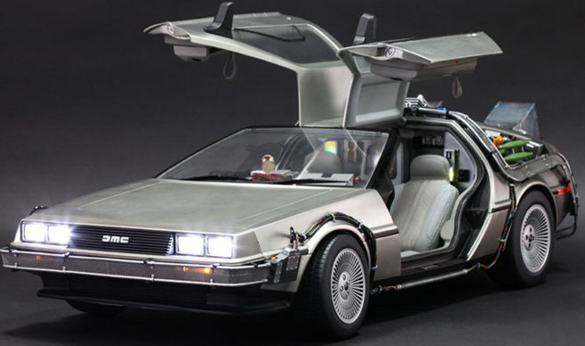
Collisions and The Running Down Clause (cont.)

Slide 7
Fast Forward, “Modern P&I”
90% of worlds ocean going vessels insured for P&I by the International Group of P&I Clubs
13 individual member clubs worldwide
Each is independent, not for profit
Competes for business
Promote insurance interests of shipowners
Regulatory
Contractually
Collective reinsurance purchase

Slide 8
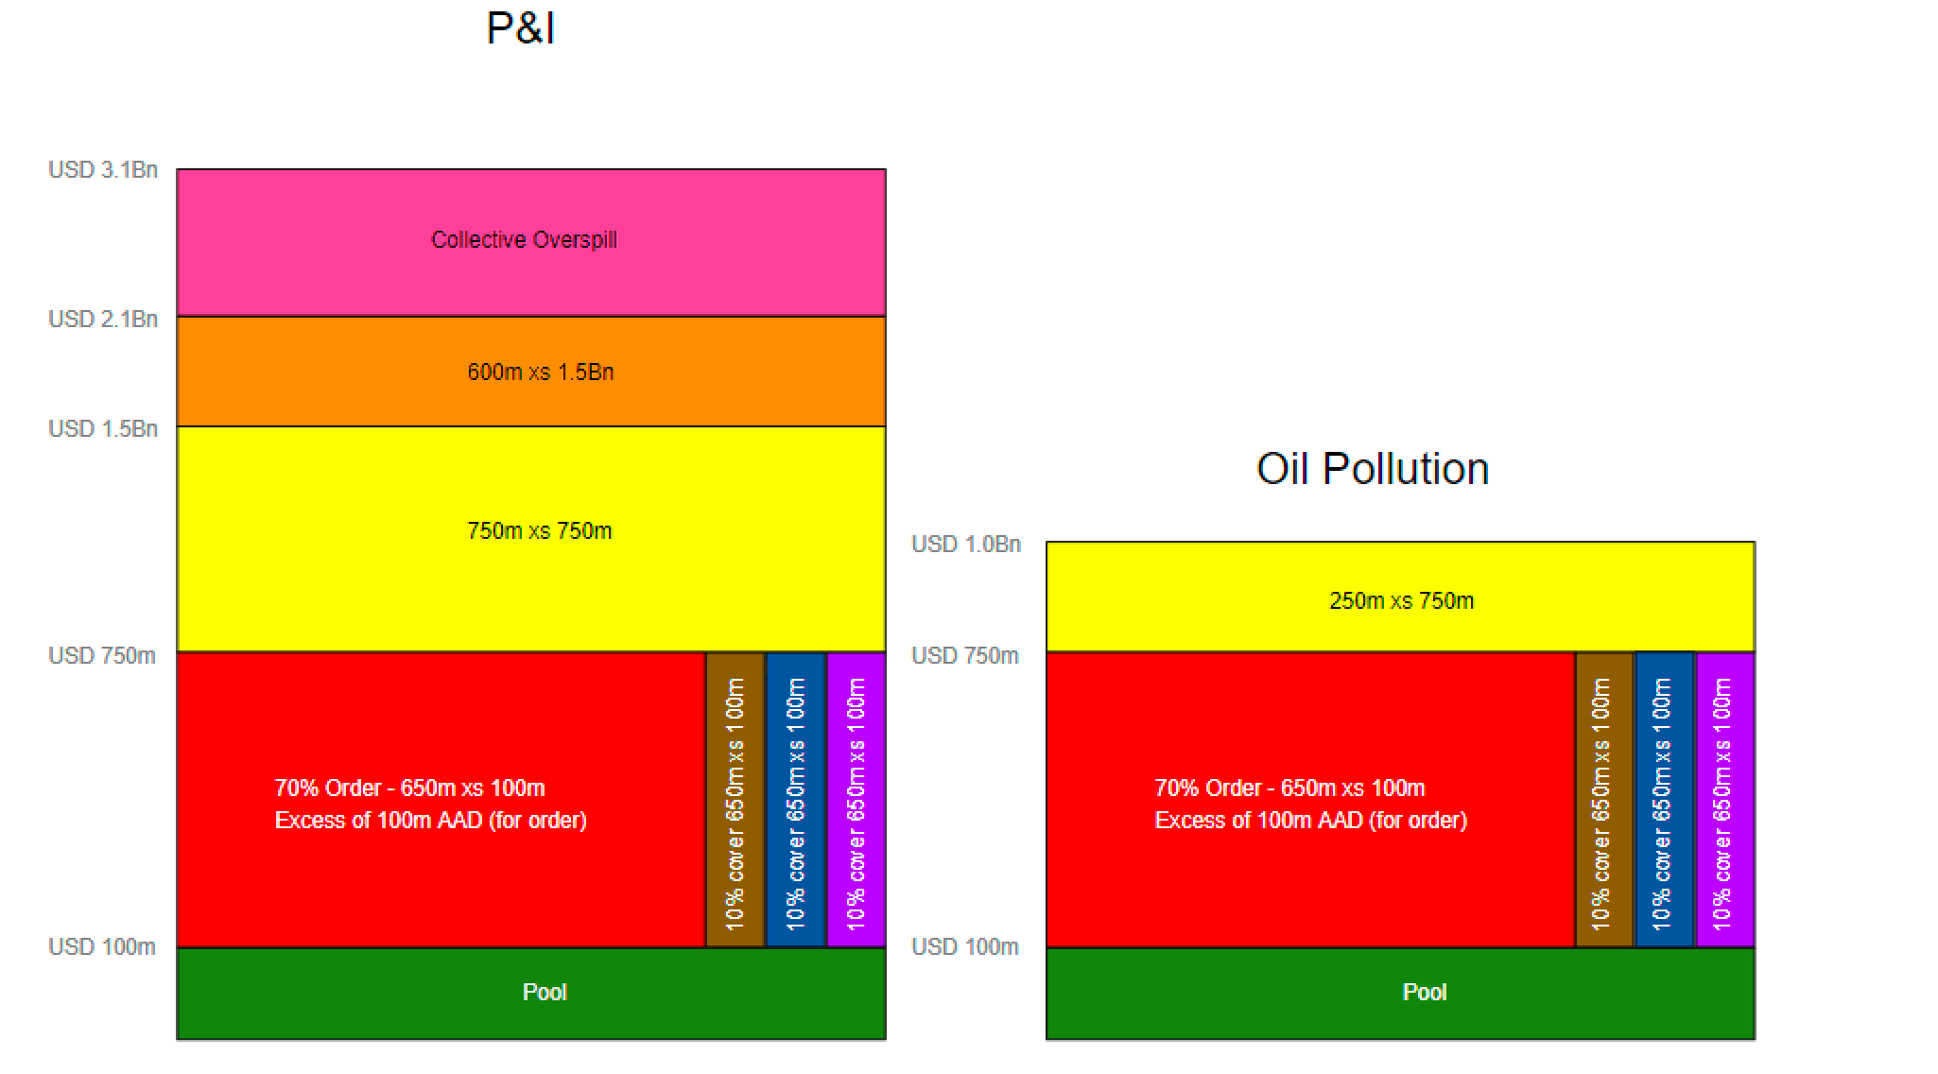
Reinsurance Structure

Slide 9
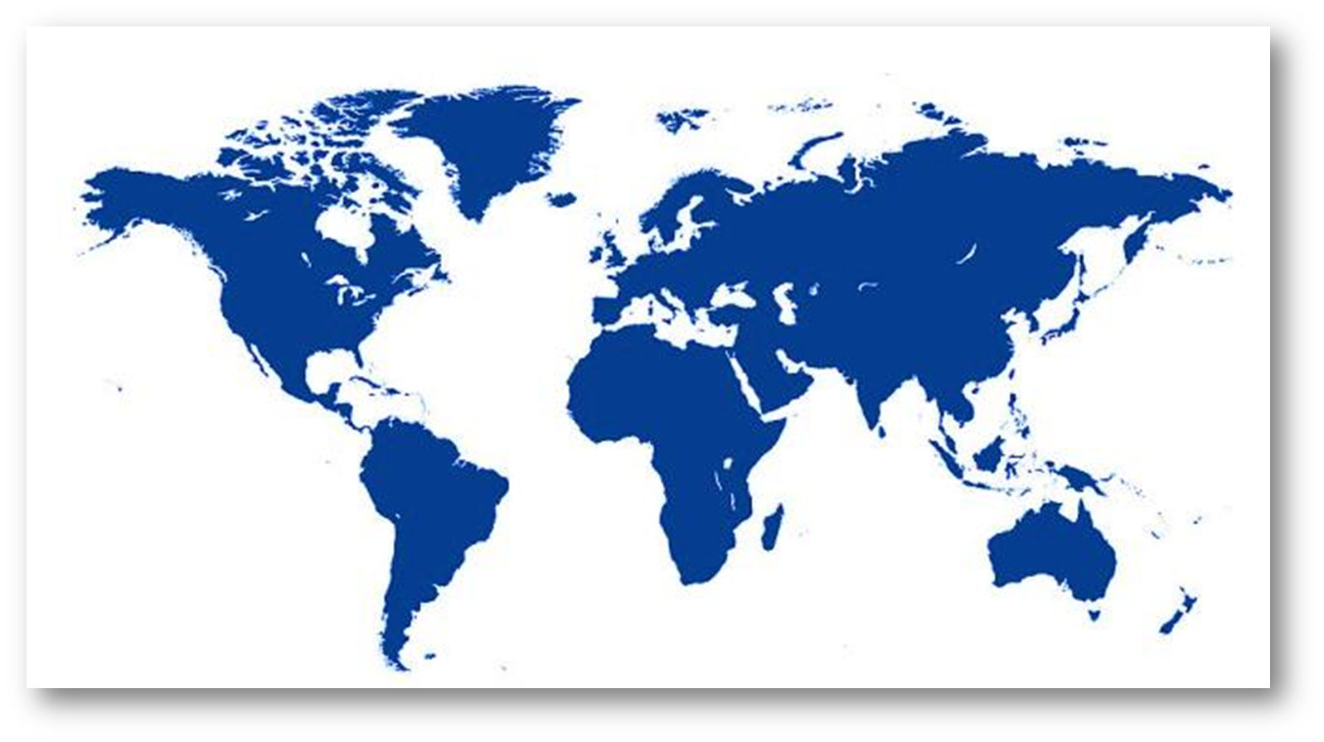
American P&I Club
Only P&I club domiciled in the USA, Headquarters in New York
100+ global team includes lawyers, surveyors, former master mariners, engineers, underwriters, accountants
Founded in 1917
Membership profile
52% EMEA
25% Americas
23% Asia
Loss Prevention

Slide 10
P&I Cover
Not an insurance policy: Rules
Insureds/members are the Insurers
Legal liabilities
Covered risks
Crew & Passengers
Collision
Cargo
Wreck Removal
Pollution
“Omnibus” clause
Freight, Demurrage & Defense
Charterers’ Liabilities
Complements Hull & Machinery, etc
More than simple risk transfer

Slide 11
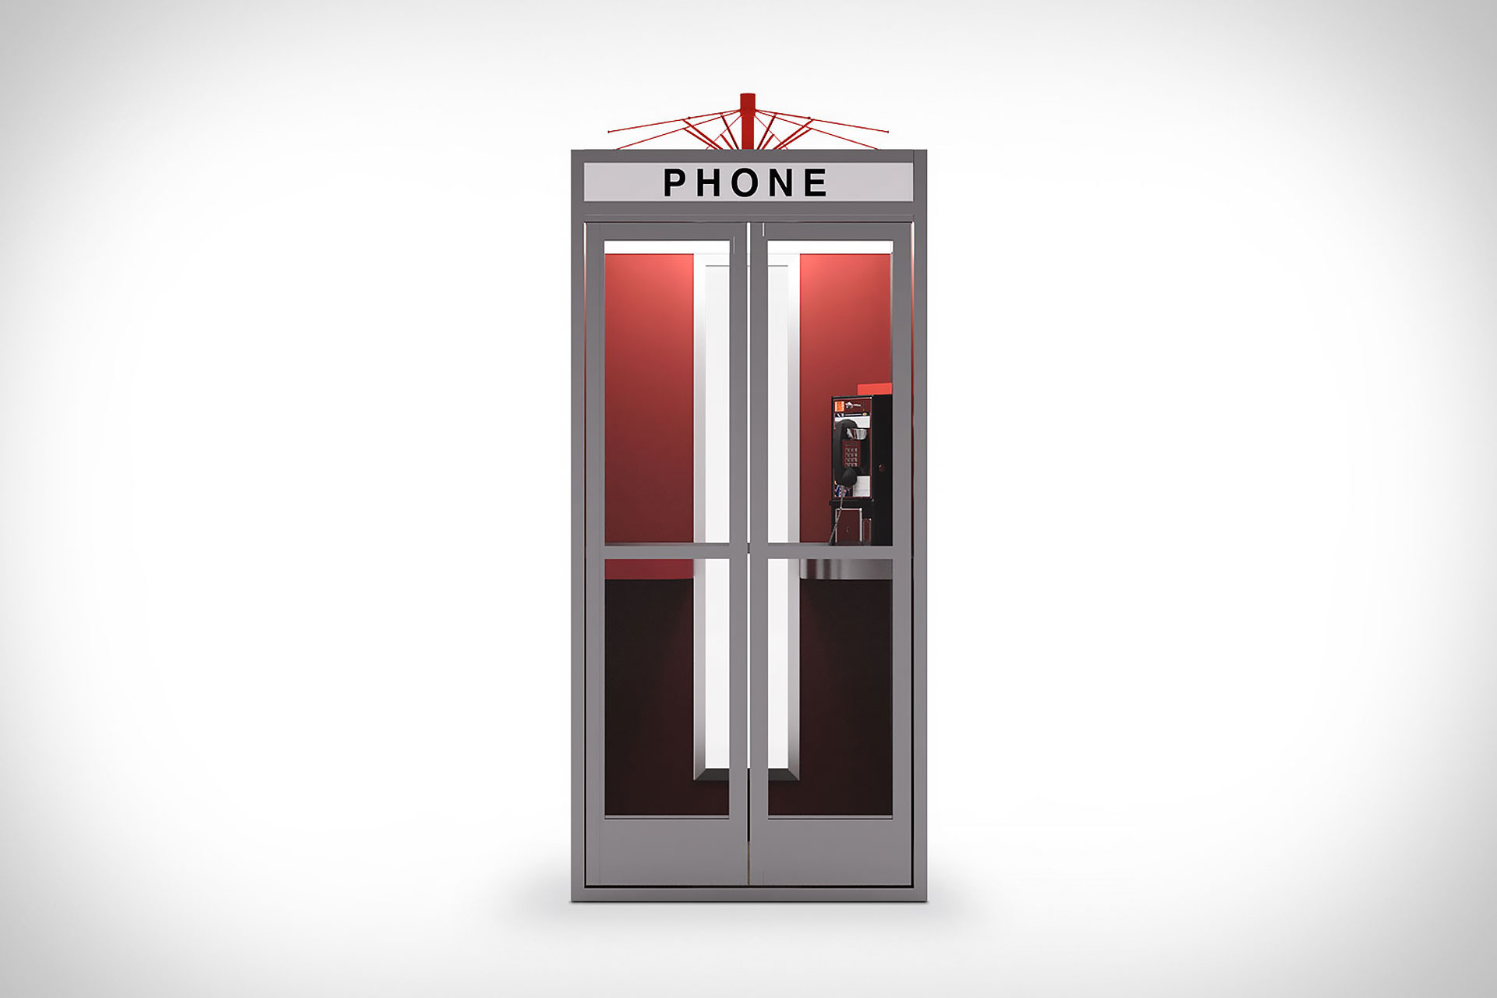
Standard P&I Cover

Slide 12
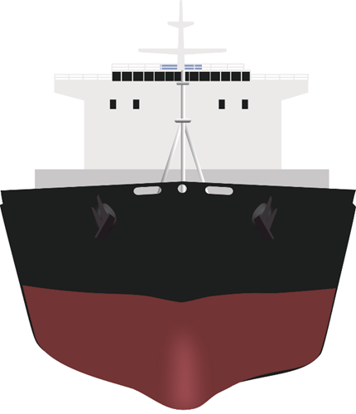
P&I of the Future
P&I clubs – innovation is in the DNA
COVID-19
The Sea around…
Regulatory creep
Clubs to find solutions and promote best practices for loss prevention/incident response/mitigation
…Under the shell-plating
Big data will assist reinsurance purchasing, however shipowner cost directed by individual performance
Automation to enhance the shipowner, broker and club dynamic

Slide 13
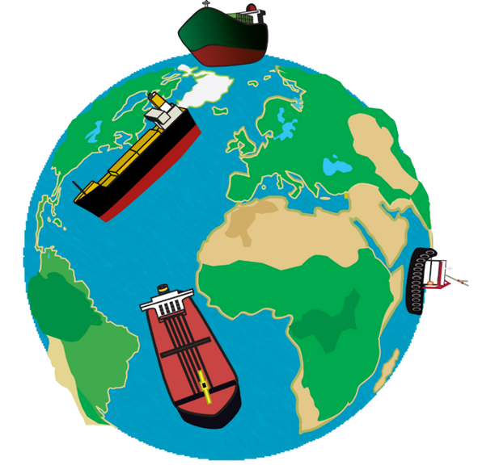
Looking further ahead – Digital Age
Hybrid work model & prepare for next pandemic
Every employee must be part of the IT team
Sustainability minded
Importance of social media
Continued diversification of offerings
Focus always on ‘Service’

Slide 14
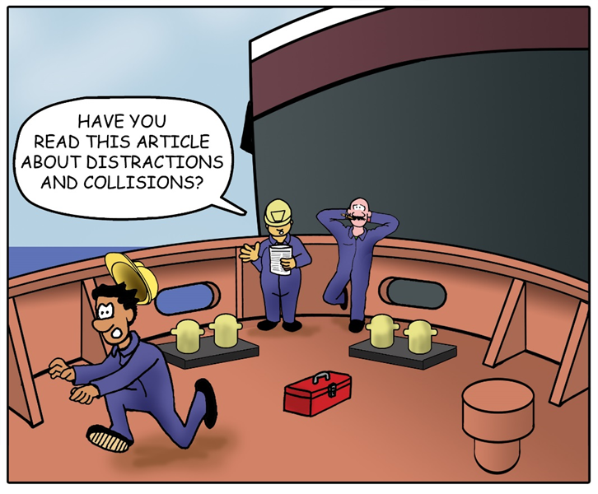
The Future of Working
Work Hard….no, work harder than those around you
New challenges for entry level and new hires
Show value to organization
Networking remains critical
Be “present” in your interactions
Use social media positively
Proficient email writing
Right attitude – chain of command
Find a good mentor

Slide 15
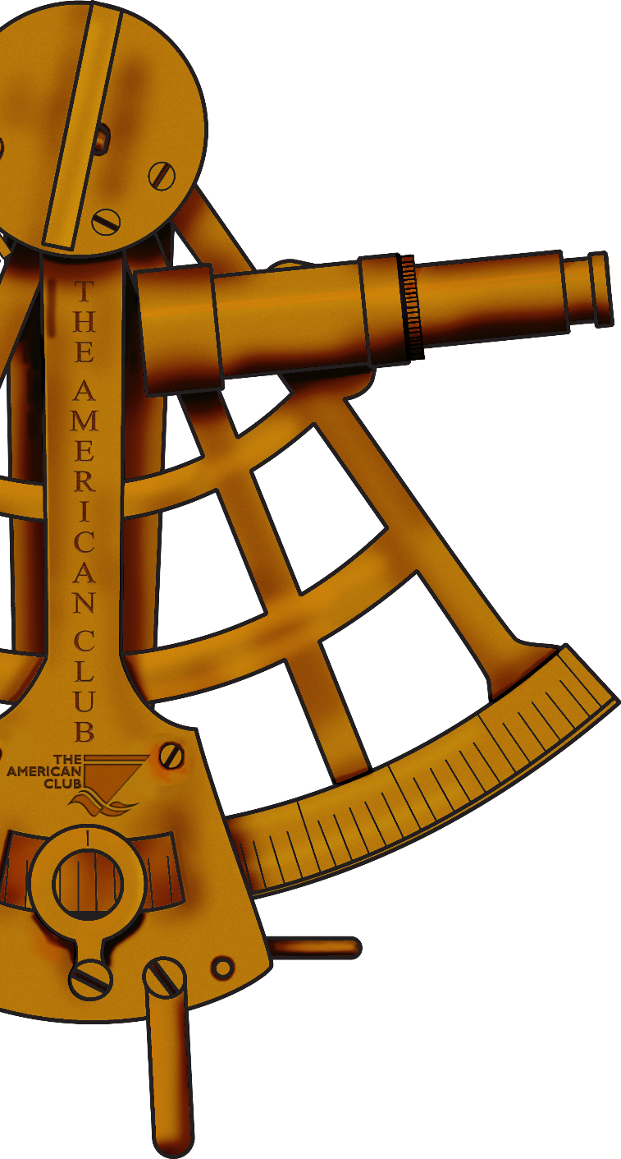
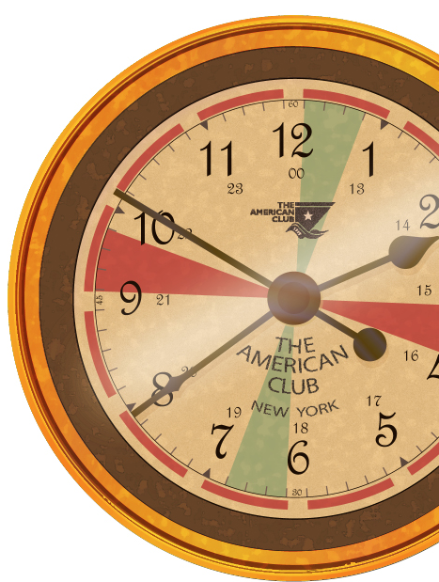
THANK YOU!
Email Me
tom.hamilton@american-club.com
or visit us on
Twitter & Instagram
@americanpandi
LinkedIn & YouTube
americanpandi

