Slide 1
Advanced Automation and Shipping 4.0 The International Perspective
Sean T. Pribyl, Esq.
Lawyer, Senior Claims Executive
Gard AS (Arendal, Norway)

Slide 3
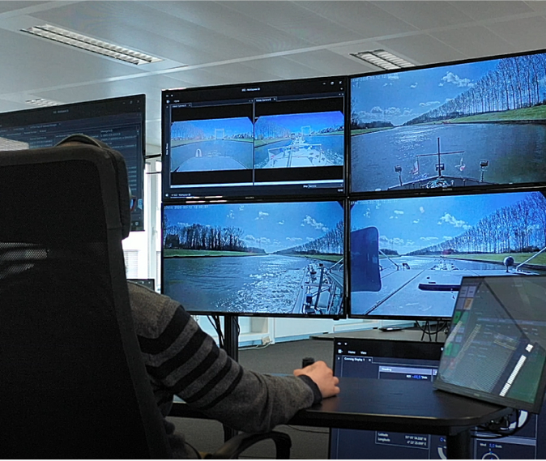
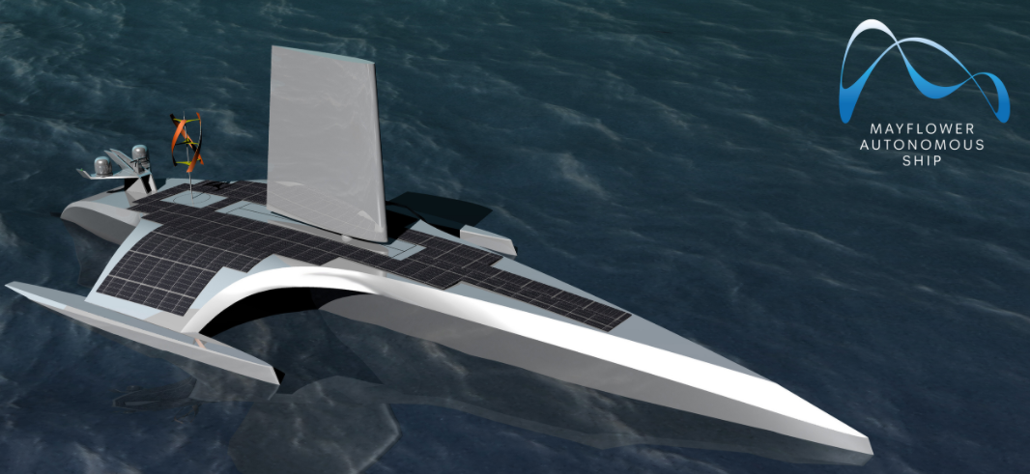
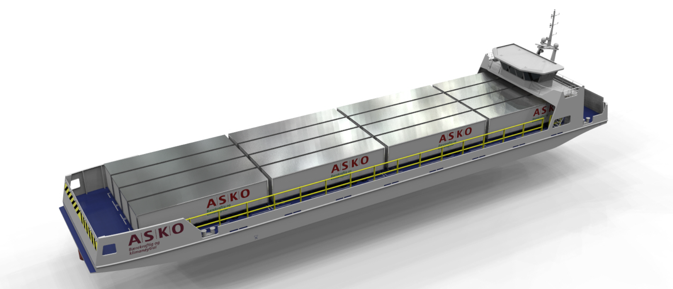
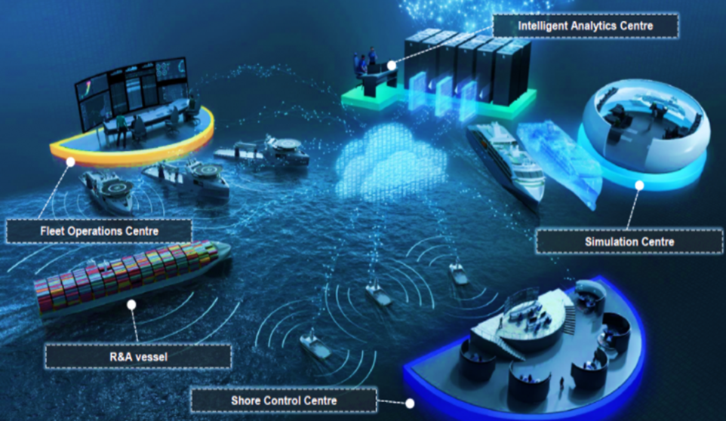
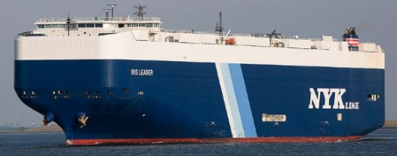
Credit: IBM News Room
Credit: Seafar
Credit: ASKO
Credit: The Maritime Executive (social media file image)
Credit: AUTOSHIP Digital Environment

Slide 4
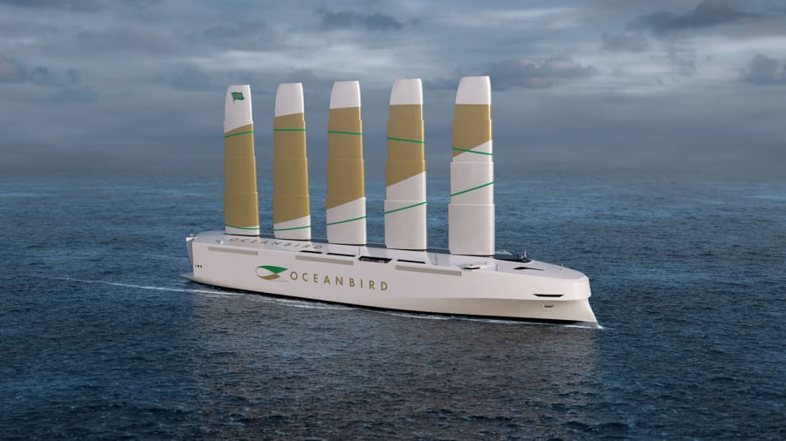
Credit: CNN/Wallenius Marine

Slide 5
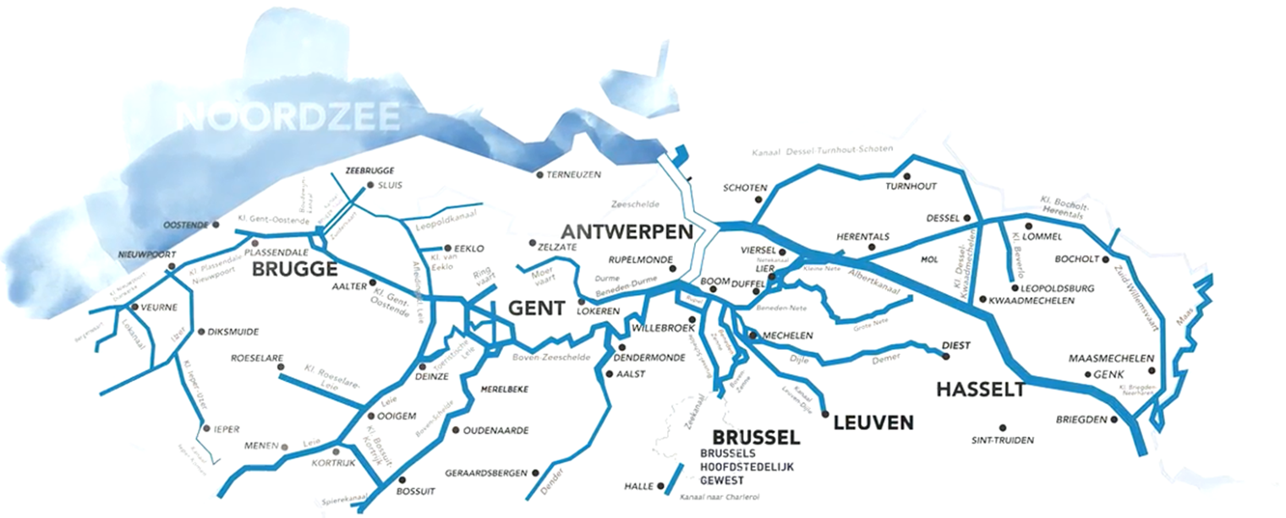
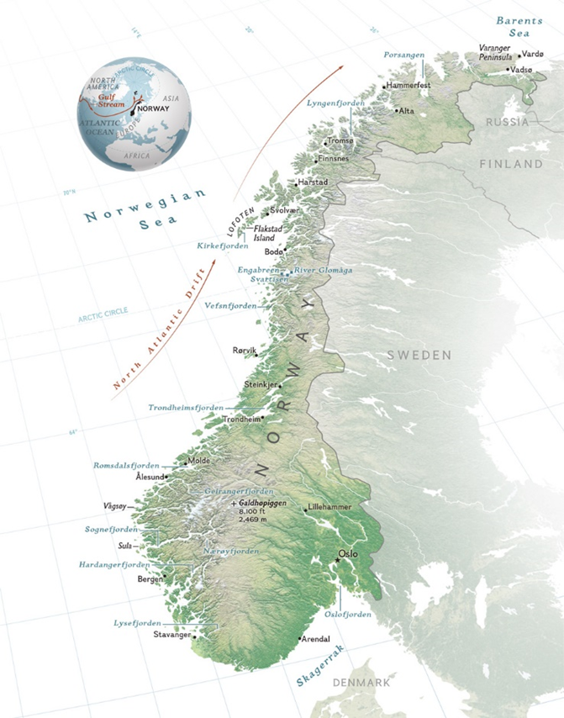

Slide 6
THANK YOU Sean.pribyl@gard.no
linkedin.com/in/sean-t-pribyl-5b28197

