Slide 1
Penfield Overview
November 17, 2020
Joe Gaudiano – Fleet Manger
Penfield Marine LLC

Slide 2
Penfield Company Overview
Company History
Penfield’s history
What is a pool
How a pools works
Where does a pool spend money to save money
What can you do as ship officers to help drive efficiency

Slide 3
Penfield Company Overview
Company History
Headquartered in Southport, Connecticut with offices in Southport, London, and Singapore
Commercially manages a fleet of 58 oil tankers ranging across 3 pools
Founded in 2012 by Tim Brennan (USMMA) and Eric Haughn (SUNY Maritime)
Employs 34 people including 6 Kings Pointers, 5 SUNY Maritime, 1 Maine Maritime, and 1 USCGA

Slide 4
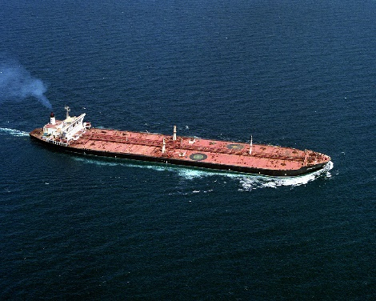
Penfield What is a Pool
Ship owners
Oil Majors
Marketing firm for individual ship owners

Slide 5
Penfield What is a Pool
Ship owners
Oil Majors
Money
Ships are ranked and paid
on their performance over
the month via the ‘Pool
Formula’

Slide 6
Penfield Traditional ownership vs. a Pool
Spot
$11,000
Pool Returns
$11,000
Time Charter
$8,000
Owners traditionally could only time charter out their ships or trade the ships in the spot market
Spot market had higher returns, but the ships did not make money during a ballast
Time Charter had lower returns but it was consistent
Pool Earnings provide consistent market returns

Slide 7
Penfield How do we keep it fair?
Speed & Consumption
Pool Ratings
-Ships are ranked on a ‘model voyage’ which considers the ships age, vetting approval, cargo intake, and most importantly speed/cons
-Speed and consumption account for 66% of the pool formula

Slide 8
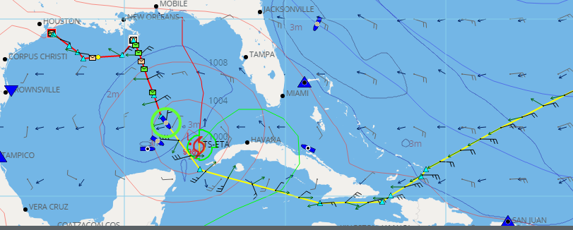
Penfield Weather Routing
IMO stated weather routing saves 3% on average in fuel consumption (1)
Penfield’s 2018 fuel consumption was $162,028,807 - a 3% savings is approximately $4.8 million
( 1) Imo reference and screenshot from stormgeo website

Slide 9
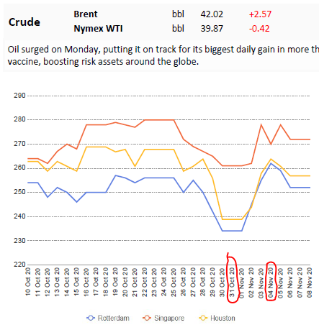
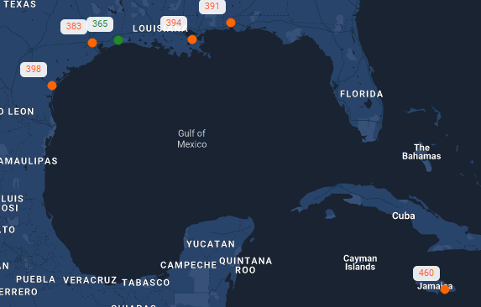
Penfield Bunker purchasing
-bunker purchasing
Between 31-Oct and 04-Nov bunkers in Houston increased $25 per MT. Saving an average panamax vessel $900 per day if stemmed early
Bunker prices between Kingston/ Houston are $95 per ton. By bunkering in Houston a ship can ‘save’ $3,500 per day
1 – pictures provided from www.clearlynx.com with permission

Slide 10
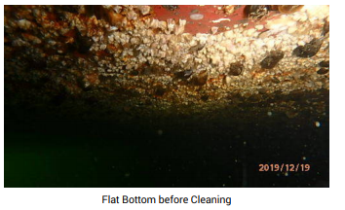
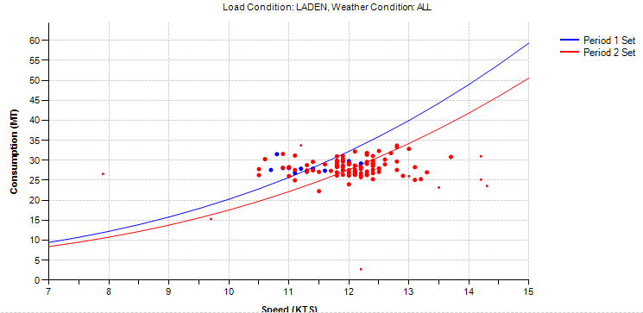
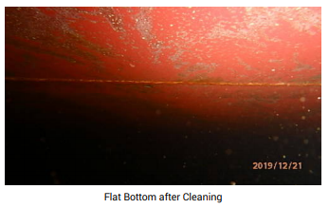
Penfield Hull cleaning
- Hull cleaning can significantly reduce bunker consumption (below example is 12.5% or 4 mt per day)
( 1) fuel consumption graph taken from storngeo’s website

Slide 11
Penfield What can you do as an officer
- Embrace technology and understand where it can increase efficiency
Always try to converse fuel
Be aware of abnormal things onboard (are you heating cargo consistently/are auxiliary machines running without a purpose)
Discuss with service providers and companies' potential savings (reduce RPM if favorable weather, increased consumption with no reason last voyage, etc)

