Slide 1
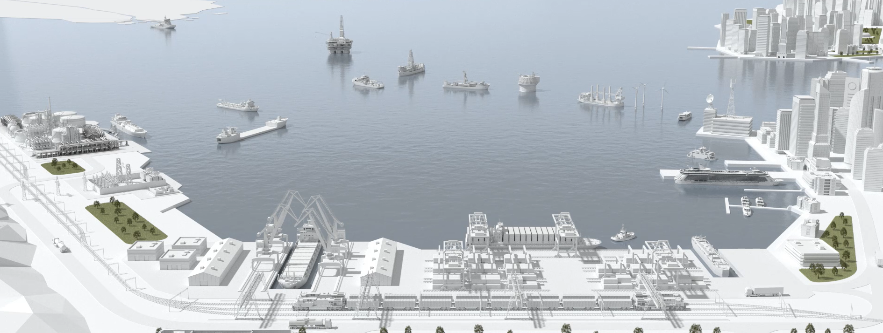
ABB Marine & Ports
Developments in automation are allowing for the next generation of low/zero emission electric vessels
Electric. Digital. Connected
Ed Schwarz, VP New Build

Slide 2

Introduction
ABB Marine & Ports
ABB Marine & Ports
Ed Schwarz
Vice President of New Builds
At the forefront of driving the evolution of sustainable shipping.

Slide 3


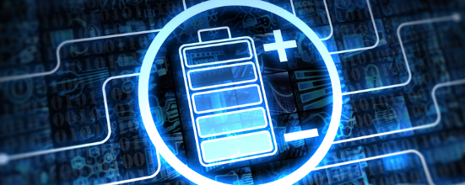



Global megatrends transforming shipping
Exponential changes are expected in near team future
Digitalization
Urbanization
Carbon Free Resources
Automation and Robotics
Global Economic Shift
Environment

Slide 4
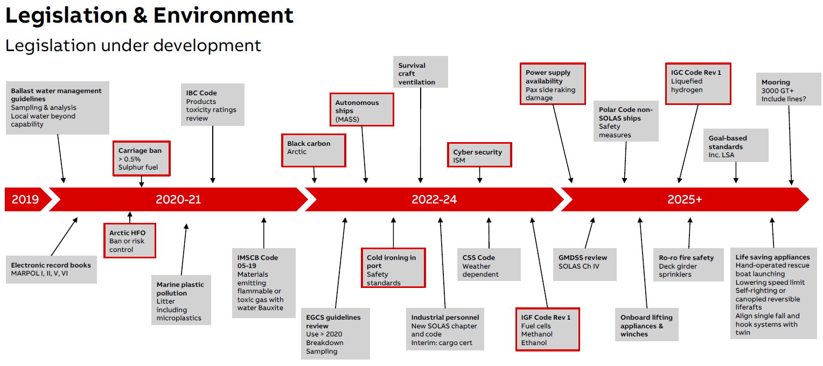

Slide 5
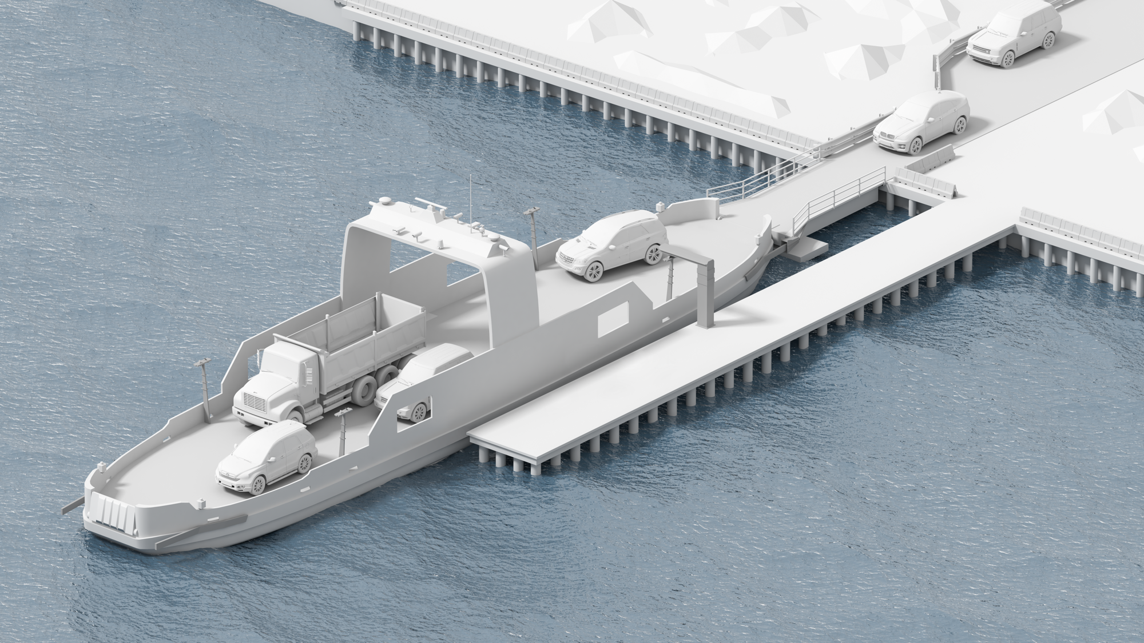



Next generation vessels will be Electric. Digital. Connected.
—
Future vessels are - Electric. Digital. Connected.
SAFE
EFFICIENT
SUSTAINABLE
Proven power and propulsion solutions combined with the latest digital technology enable safer vessel operations, protecting people and assets.
Pioneering solutions that optimize operational efficiency by enhancing productivity and reducing cost throughout the lifetime of the vessel.
We are committed to supporting the shipping industry’s low carbon future through technologies that power the world without consuming the earth.

Slide 6
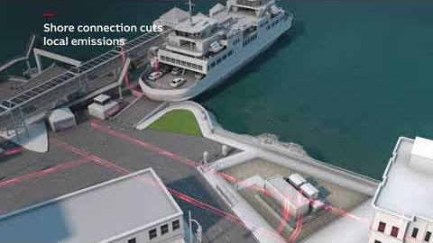

Slide 7
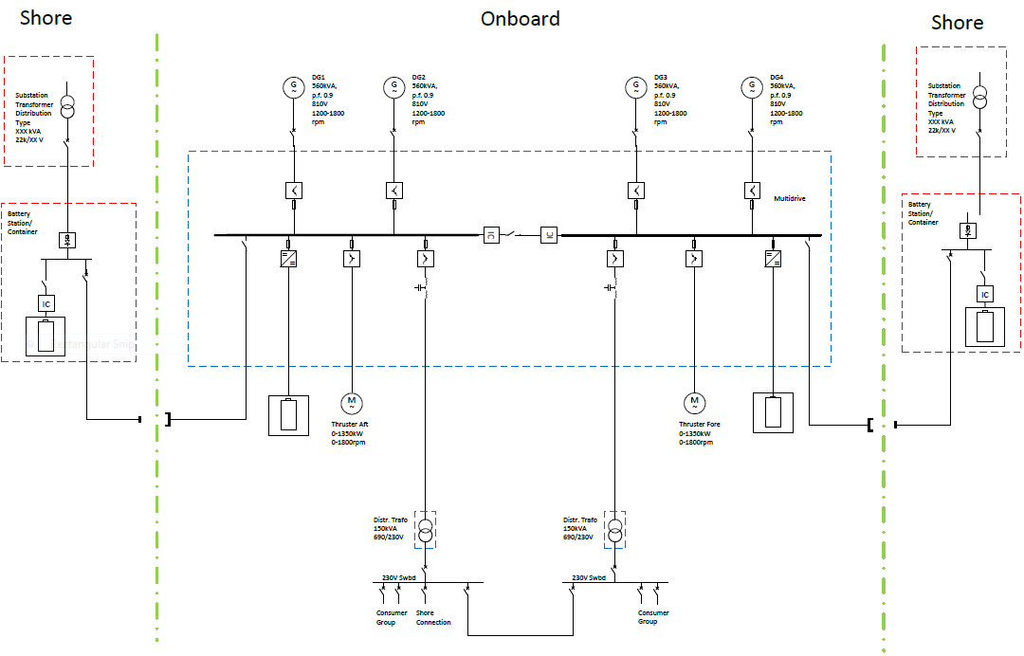


Typical solution for electrical plug-in ferry- utility to propeller
22kV power grid
690V AC or 1000V DC charging station
Alt. Battery
1000kWh
Alt. Battery
1000kWh
Charging plug
Charging plug
Battery
700kWh
Battery
700kWh

Slide 8
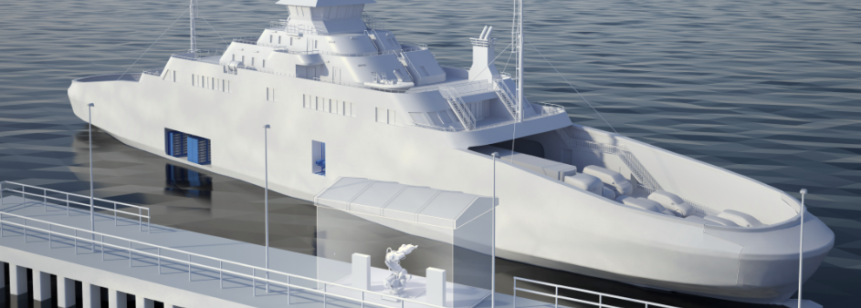
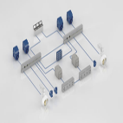
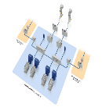

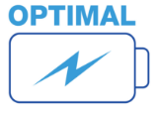
Next generation electric power and propulsion relies on automation
Thousands of hours of automation engineering go into new vessels
Onboard DC grid
Dynamic AC
Charging
Energy Storage

Slide 9
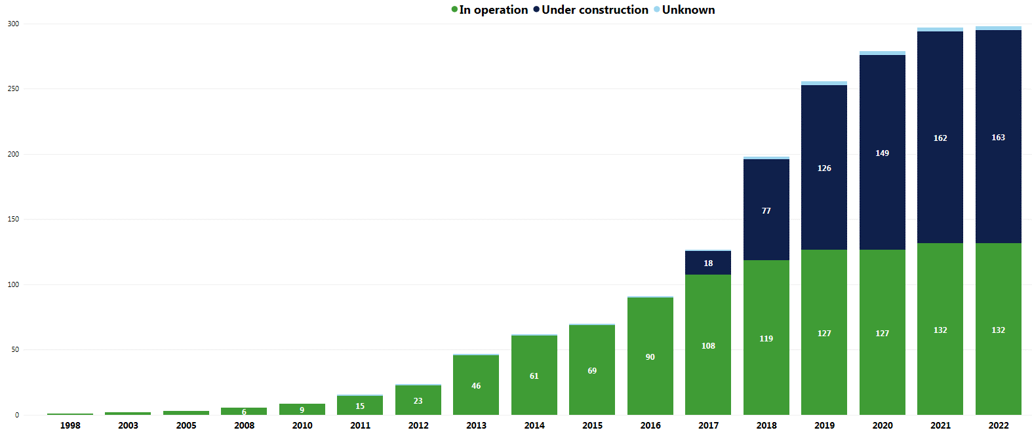
Energy Storage – at the Leading (not Bleeding) Edge
Total number of ships with batteries
* Source Maritime Battery Forum

Slide 10
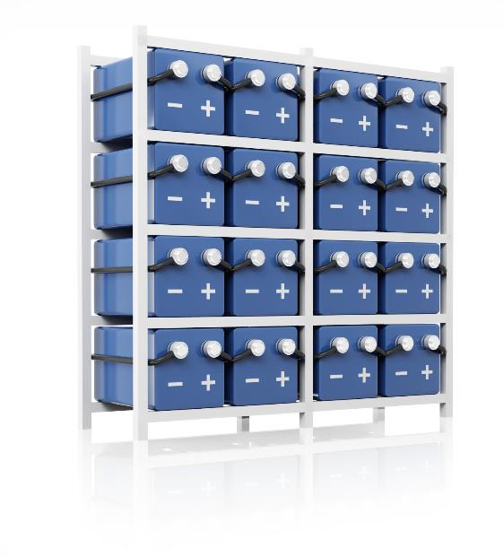
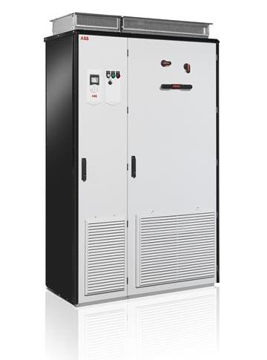
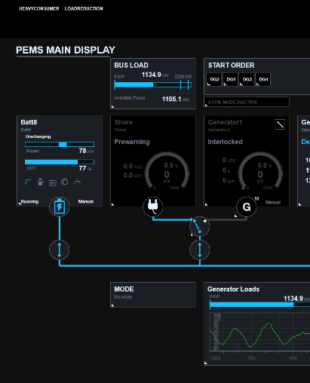
Energy Storage System
What is an Energy Storage System
Battery
Converter
Control System
+
+
Modern energy storage systems would not be possible without automation engineering

Slide 11
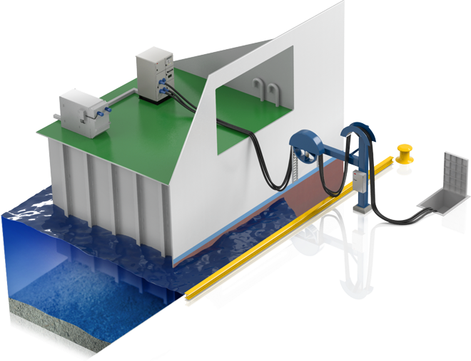





Shore Charging Main Considerations
First considerations
Charge Time
Energy Required & Bus Voltage
Dock Space and Arrangements
Manpower (automated / manual)
Power Grid Capacity

Slide 12
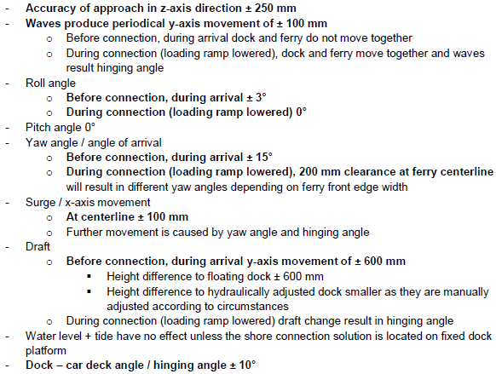
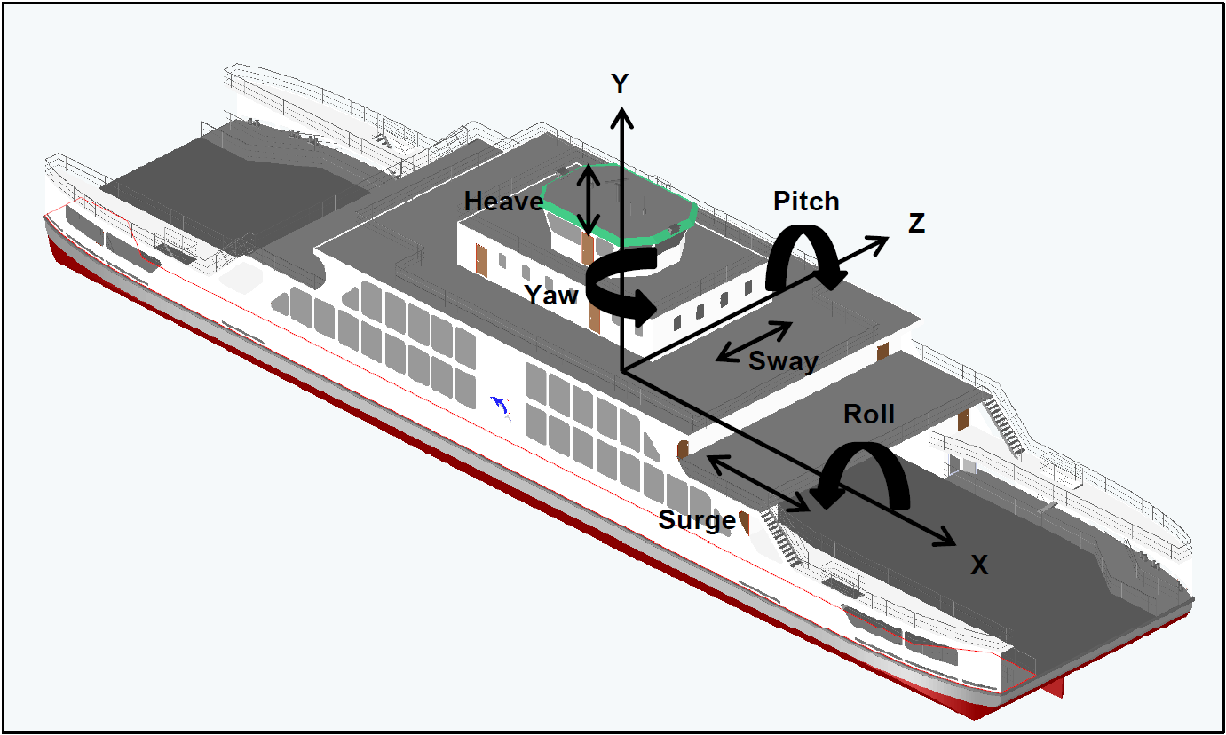
Shore Charging Considerations
Second considerations
Definition of design parameters
Realistic ferry movement limits during arrival and charging
To be compatible with selected pier structures

Slide 13
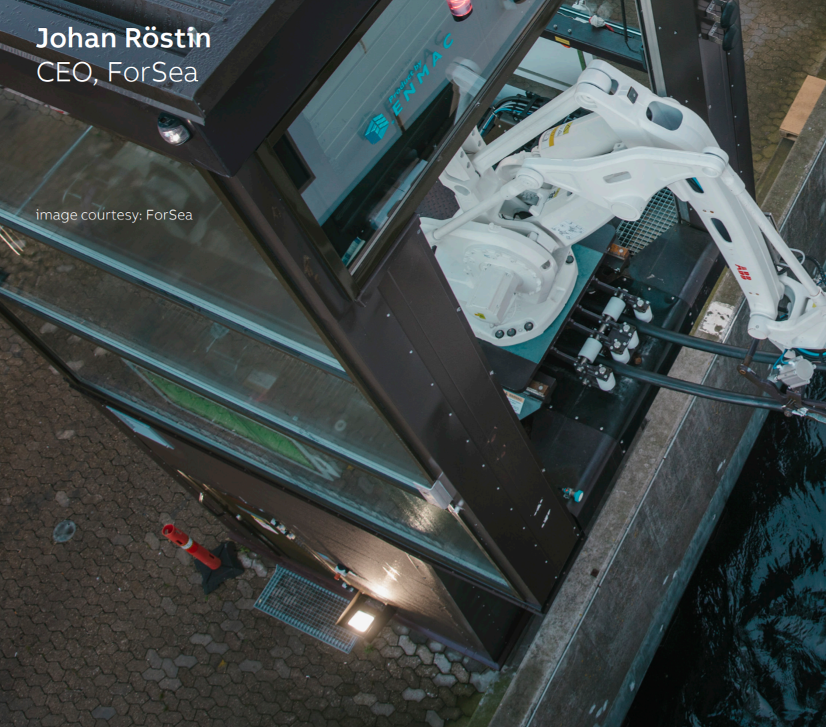
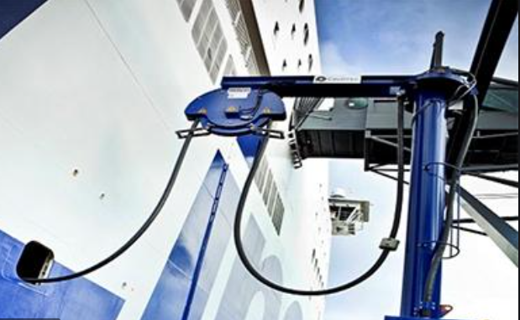
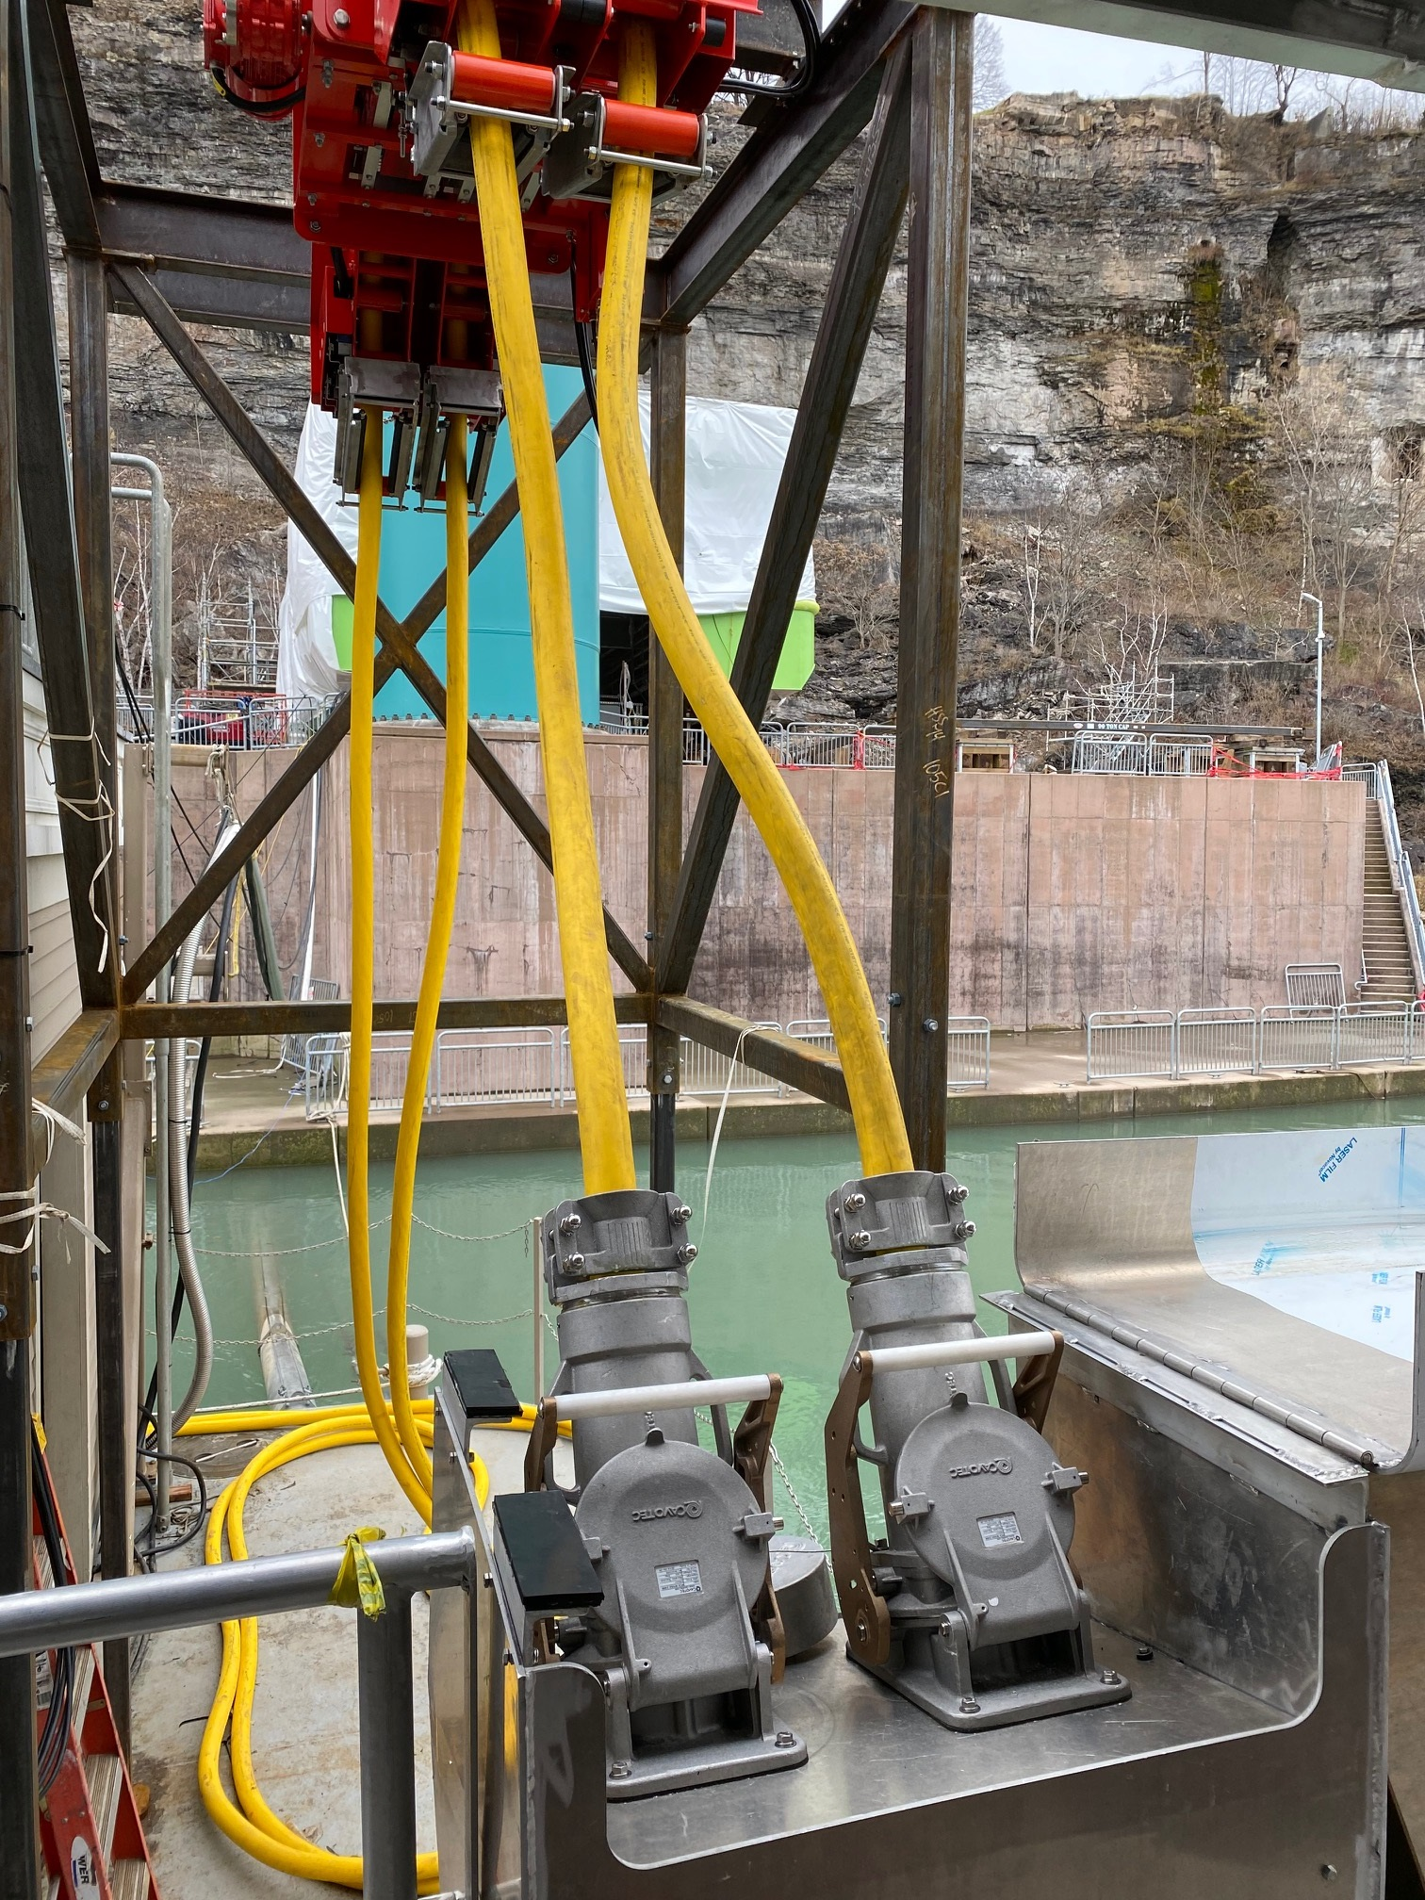
Shore Connection / Charging Approach
Charging types – need to evaluate fit for purpose
Power
Automatic Connection
Crane assisted manual connection
10 MW
Manual Connection
< 100 kW
Seconds
Minutes
Hours
Connection Time

Slide 14









Shore power to drive new electrical vessels
In summary electrical ferries are only possible through advancements in automation engineering
1000V DC Auto-connection
690V AC/ 1000V DC
22kV/ 690V AC
22kV AC

Slide 15
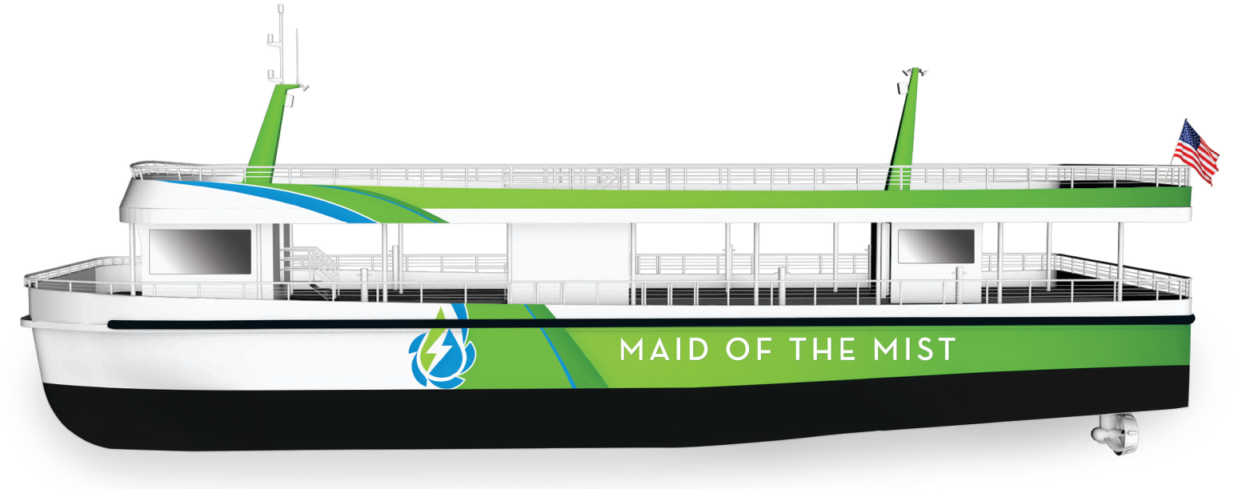
Maid of the Mist
Fully Electric Passenger Ferry – Niagara Falls
Vessel information
Vessel name: Maid of the Mist
Vessel Type: Passenger Ferry Catamaran
Design: Propulsion Data Services
Yard: Burger Boat Company
Year: 2019
Class/Authority: USCG Subchapter K
Owner: Maid of the Mist Corp.
Solution and Scope
Other Information
Energy Storage: 2 x 158kWh (Spear Power Systems)
Shore Charging: 2 x 350kW cables @ 7 mins b/w voyages (Cavotec)
Propulsion: 2 x 200kW L-drives
2 x 50kW bow tunnel thrusters
Automation: PEMS with integrated VMS
Advisory: ABB Remote Diagnostic System
Among the ﬁrst all-electric passenger vessels in North America
Utilize Li-ion batteries storing hydroelectric power producing zero emissions
Operates nearly silently with little to no vibration
Complete redundancy in propulsion with independent systems in each hull
No diesel or combustion-based backup propulsion system

Slide 16
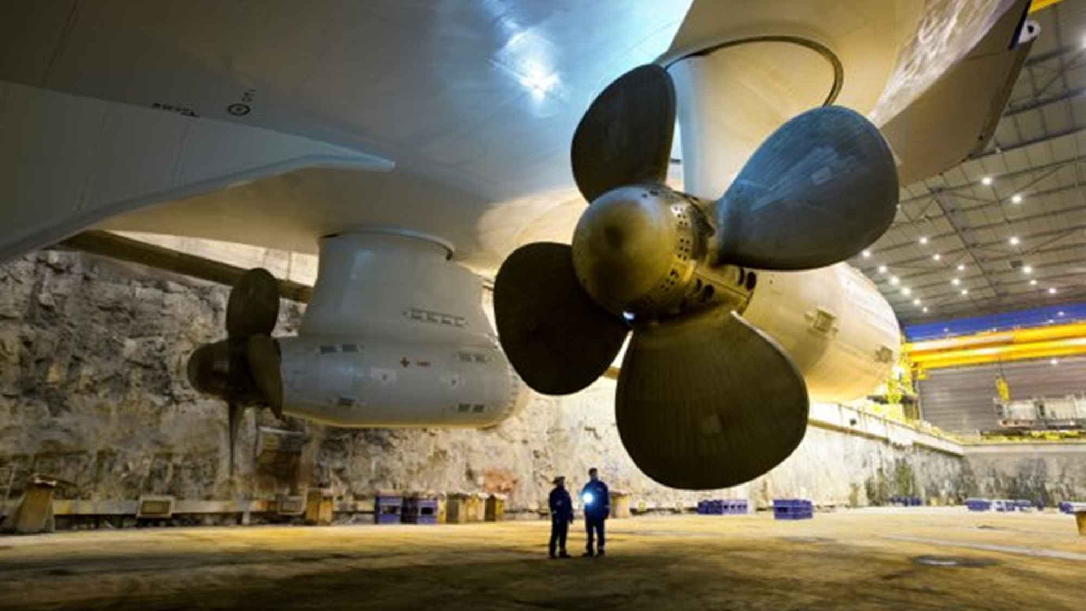
Marine & Ports
Our operations in numbers
Global footprint
We are in 26 countries, 40 locations.
Were are over 1,800 professionals serving over 3,500 customers.
Average over $1B in Marine electrical & propulsions projects annually.
Trusted to develop some of the worlds largest electrical propulsion systems (>24MW).

Slide 17
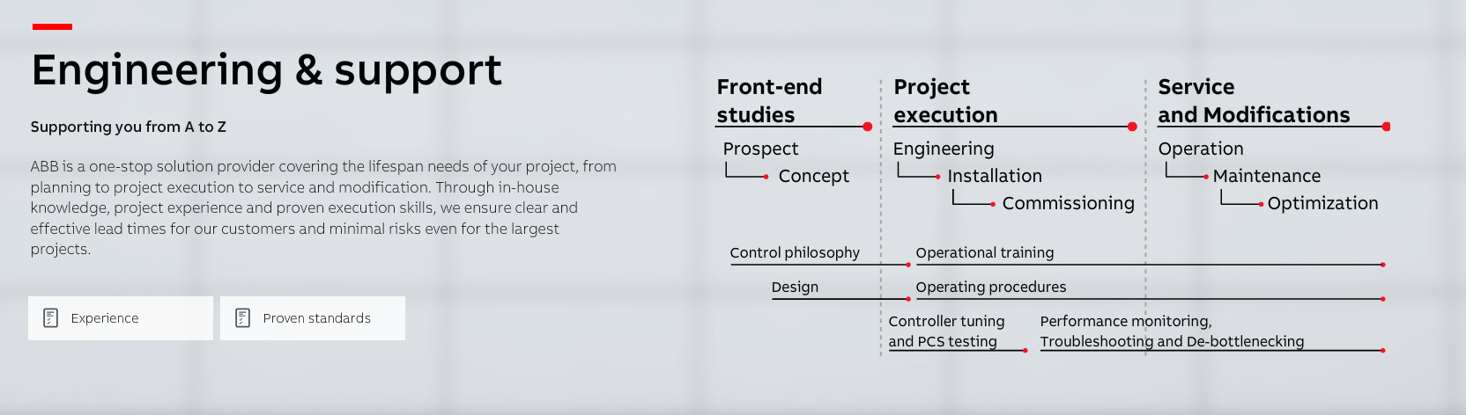
Complete provider
From design to operational optimization

Slide 18

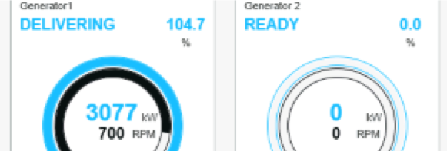
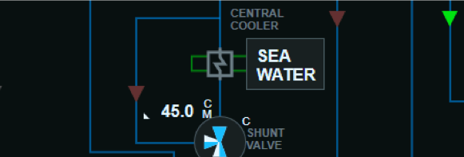
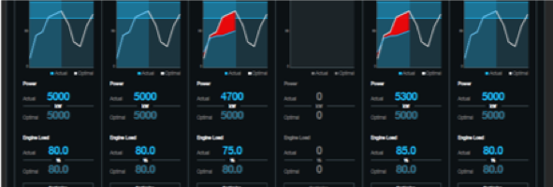
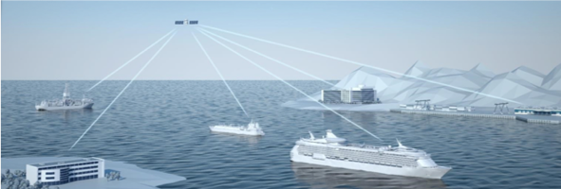
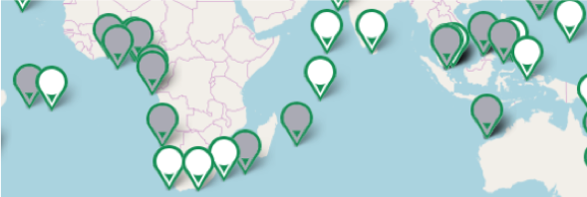
ABB Marine Digital Portfolio
Next Generation Awareness & Maneuvering
Precision & Reliability
The Power of Integration
ABB AbilityTM Marine Pilot Family
Sub system control and monitoring
Single view for all systems & equipment
Real Time Vessel Advice
24/7 Service & Support
Digital Journey
Advisory
Smart Asset Management and Security
Transforming & empowering operations
Notes:
Insert products here by category

