Slide 1
November 18, 2020
Secure Access
Data Protection End Point Management
DigiMariner
Daniel E. Turissini
dturissini@spyrusWTG.com

Slide 2
Secure by design
Secure by design (SBD), in software engineering, means that the product has been designed from the foundation to be secure. In such an approach, the alternate security tactics and patterns are first thought; among these, the best are selected and enforced by the architecture design, and then, they are used as guiding principles for developers.¹
¹ "A Catalog of Security Architecture Weaknesses". 2017 IEEE International Conference on Software Architecture (ICSA). doi:10.1109/ICSAW.2017.25.

Slide 3
Information vs Data
Information is a processed, organized data presented in a given context and is useful to humans.
Data is an individual unit that contains raw material which does not carry any specific meaning.
Information is a group of Data that collectively carry a logical meaning.

Slide 4
STEM and Critical Thinking
Risk = Probability of <Bad Things> multiplied by the Impact
[R = P * I]
Reducing R means:
Reducing the probability of bad things happening [Controls, Protections, Preventions]; and,
Reducing the impact of bad things [Redundancy, Detection, Reaction, Correction]
In order to do this:
Must understand both P & I
What is important in your environment?

Slide 5
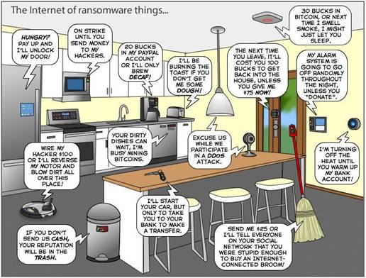
Network-Enabled Devices are Vulnerable!
Smart Ships, Ports, Aids & Enterprises need a new systems-based defensive approach that eliminates human weaknesses.
The cyber problems cannot be solved with simple overlays, monitoring & training.
Focuses must be on interoperability, trustworthiness & privacy/ critical infrastructure protection.
The Power of Simple - strong cyber-solutions & best practices without complicating the user experience, thus removing the opportunity for compromising mishaps.
http://www.geekculture.com/joyoftech/joyimages/2340.png

Slide 6
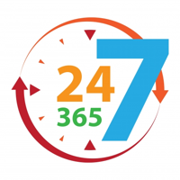
IoT of Things you can Trust
Confidentiality
Avoid unauthorized disclosure
Tools:
Encryption
Access Control
Physical Security
Avoid unauthorized changes
Tools:
Digital Signature
Backup/ Archiving
Checksum
Data Correcting code
Integrity
Accessible & usable in a timely fashion
Tools:
Physical Protections
Redundancy
Availability

Slide 7
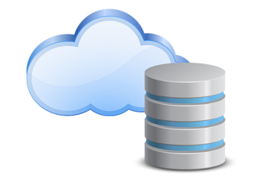
Addressing Protection in each State
Process
Storage
Communication

Slide 8
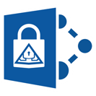
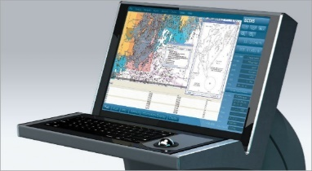
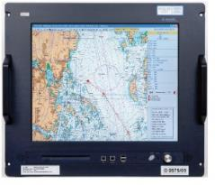
Securing On-Premise & Cloud-based Services
Securely connect
billions of end points …
… over secure communications connection …
… w/ CLOUD/ Data Center security built from ground up.
END POINT SECURITY
CONNECTION SECURITY
CLOUD SECURITY
Provisioning, Registration & Authorization
X.509/TLS-Based Handshake, Strong Encryption w/ IPSec options
Security Center, Directories, Key Vaults, Policy-Based Access Control
Recognize Convergence of OT & IT

Slide 9
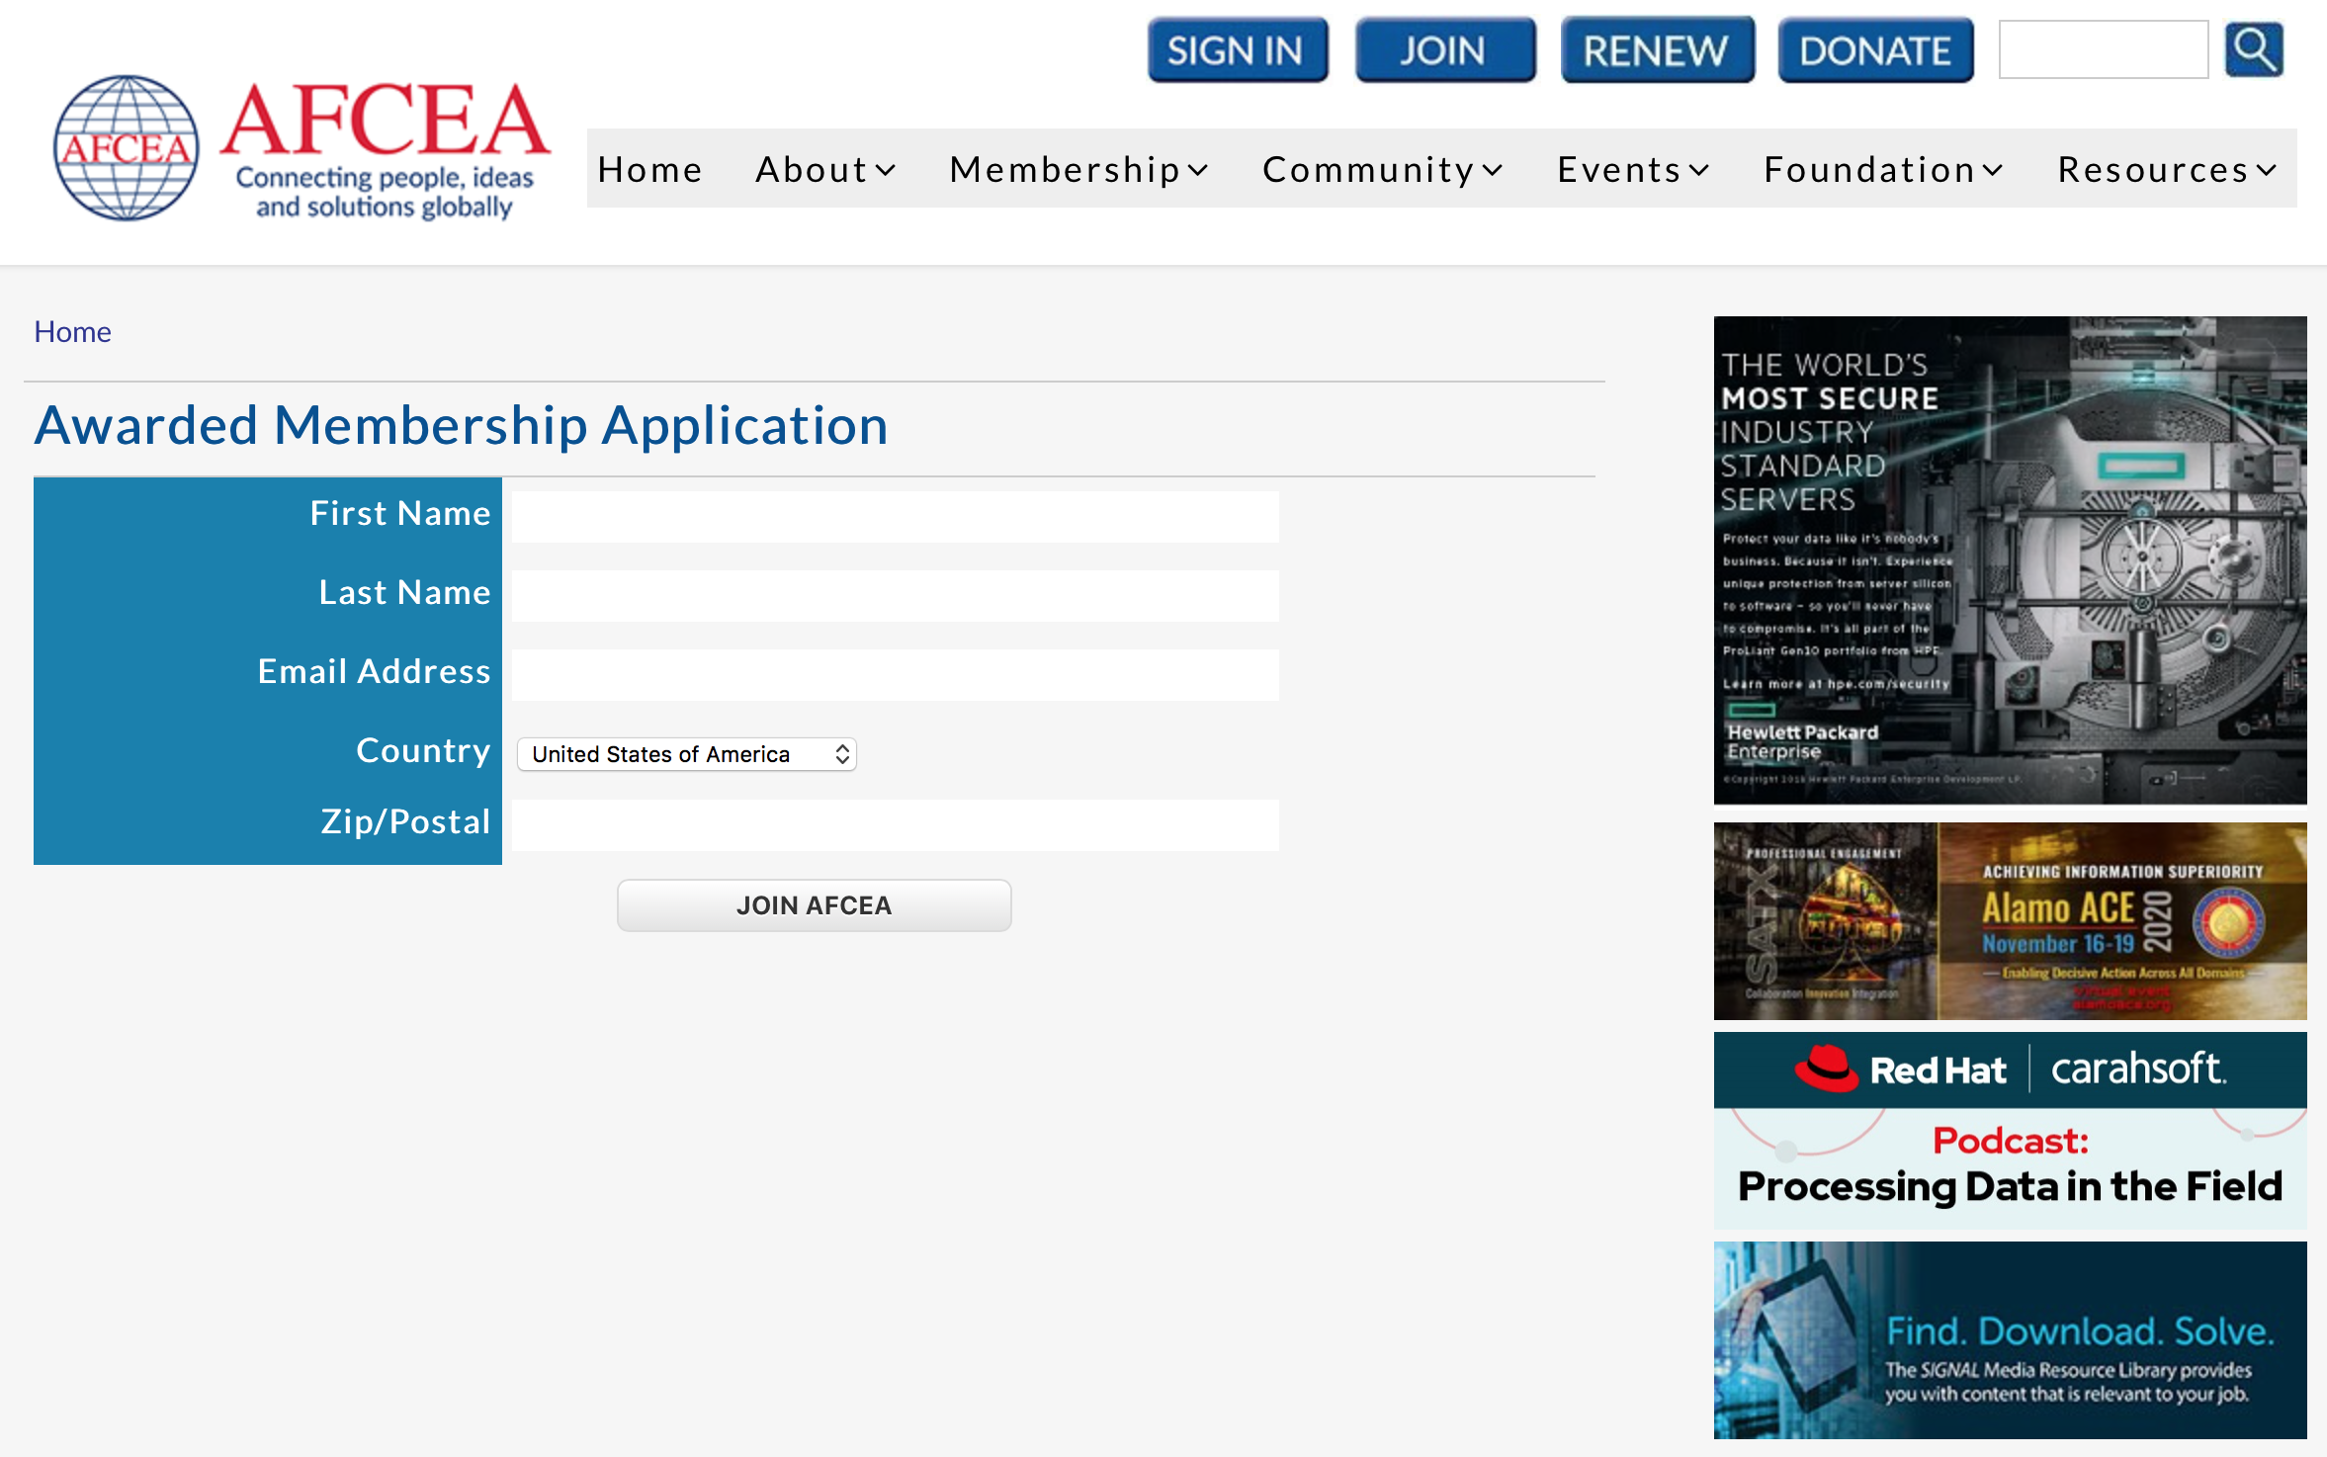
www.mtsociety.org
https://www.afcea.org/portal/imemb/newawmbexp.jsp
Daniel E. Turissini dturissini@spyruswtg.com Thank You!

Slide 10
Thank You!
DigiMariner
Daniel E. Turissini
dturissini@spyrusWTG.com

