Slide 1
DIGITAL CULTURE
Cameron Amigo
11.18.20

Slide 2
DIGITALIZATION
THE PROBLEM
WHAT IS DIGITAL CULTURE
YOUR CULTURE
INNOVATION

Slide 3
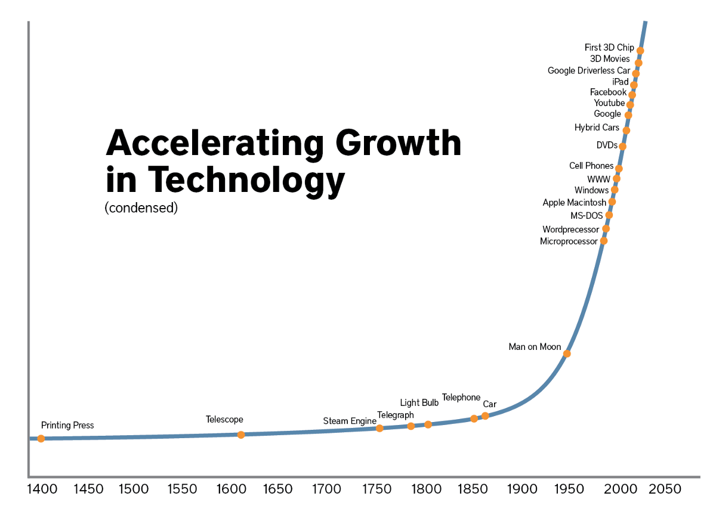
PROBLEM
Digital Transformation
Technology
Process
People

Slide 4
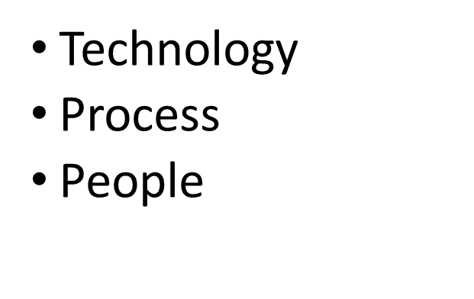
culture
Commitment + Creation

Slide 5
HIGH COMMITMENT
Cozy
Innovative
LOW CREATION
HIGH CREATION
Apathetic
Stress
LOW COMMITMENT

Slide 6
WHERE IS YOUR ORGANIZATION?
Determine your existing culture
WHICH TYPE OF LEADER ARE YOU?
Reflect on your leadership style
APPLY COMMITMENT & CREATION
Each region, office, department, team, and individual is different
CULTURE ISN’T BUILT OVERNIGHT
The best time to start was 10 years ago, the next best time is today

Slide 7
THANK YOU
CAMERON AMIGO
+1 (740) 706-6690
c.amigo@spimarine.com
COMMITMENT / CREATION

