Slide 1
Recent Graduates & the Digital Age
From Sailing to Shoreside jobs and how the
Digital Background you form will serve you through your transition
Kate McKenna ’14
Notes:
Hi Dave thank you so much for having me!
My presentation will focus on Recent Graduates and the digital age. I appreciate you asking for my perspective on where companies are moving with the ever-changing technology of the world, and how midshipmen can be prepared to adapt to this in the future.

Slide 2
Kate McKenna – USMMA 2014
USMMA Class of 2014
BS in Marine Transportation
Upon graduating, joined IOMMP as a 3rd Officer and began my seagoing career
Completed various SSO ADT’s throughout my sailing time.
Extended assignment within the Military Sealift Command DPA Department, working as the assistant DPA and various ISM Code element implementations for new classes of vessels.
Joined APL Maritime LTD, part of the CMA CGM Group, as the Operations Manager for US Flag Fleet.
Joined Deloitte & Touché LLP as a consultant within the Government and Public Sector, in the Enterprise Performance Offering in the Supply Chain and Network Operations Portfolio.
Notes:
I graduated from USMMA in 2014 and upon arriving at the academy as a plebe, that was the first time I had to take notes in a notebook since prior to high school. I was fortunate enough to go to a private “smart” school in new jersey and had previously been exposed to an entirely digital environment. Going back to an old school way of pen and paper was a large adjustment for me and one that I was disheartened to see during my early days at the academy.
Throughout my time at the academy I sailed with four different companies during my sea year, all who were embracing the future of the “digital age” differently. Some ships we all had emails, some ships with full free internet, and other we didn’t have anything. It was not until shipping out as a 3rd Mate that I was truly exposed to the technological gaps between what I had learned during my education and what was in practice with various companies. From joining the union I was exposed to all different companies, each with their own technological implementation plans focused on one thing or another, depending on their business model.
I continued to maintain my reserve commitment within the SSO Program and was also able to take some ADT’s that exposed me to more of the business side of the industry through Military Sealift Command. My most impactful ADT in regards to digital technology included working with the DPA on the implementation of new policies and procedures for various classes of vessels and their digital implementation of their Safety Management Systems and Planned Maintenance Systems.
I used this ADT as an opportunity to test drive a shoreside work environment. I was not sure if I would be able to make the transition or adjust to working in an office environment. I also took this assignment as an opportunity to determine where my tech skills were proficient and what I needed to learn about to make myself competitive coming into a shoreside role.
From that ADT I transitioned into a shoreside capacity for APL Maritime where I served as Operations Manager for the US Flag Fleet, working on an extensive amount of projects that centered around technological advancement and keeping up with the ever-changing industry standards. The implementation of NIST 1001, which includes Cyber Security Framework for the Maritime Industry and Government Contractors was a huge driving force in where our onboard environments were headed. I also completed a complete evolution of our training platforms, implementing a fully capable and utilized Online Learning Management system. We brought training to all our people at any time, overcoming many technological hurdles, but continued to focus on the safety and security of our crews and vessels. All these skills were developed through on the job training and personal investment in professional development.
From my role as Operations Manager, I was presented the opportunity to join Deloitte as a consultant within the government and public services sector, specifically the enterprise performance and supply chain network operations portfolio, in which I currently work. The company is very forward thinking about digital transformation and new technologies, and as a result we are constantly being offered training on new platforms and the company continues to drive technological innovation for our clients.

Slide 3
The Maritime Industry: Digital Perspective
Officer Onboard a Vessel
Digital Technological Advancements:
How are companies moving digitally?
What is the focus of the company with their digitalization onboard?
NIST 1001
How are midshipmen preparing for it?
Curriculum changes
Professional Development
What industry publications and news are you keeping up with?
Shoreside Management Positions
Digital Technological Advancements:
Cyber Security Threats
General Technological Proficiency
How are recent graduates preparing for it?
Further Education
Professional Development
Industry Publications & Standards
What is the knowledge expectation when moving shoreside?
Notes:
As a Deck Officer Onboard a Vessel:
Digital Technological Advancement goes beyond knowing how to operate the equipment and programs you use in your daily job work. Yes, you are onboard a vessel, but the vessel is always attached to a much larger organization. Understanding how to operate systems, and how components compound into larger operations, and the understanding of the entirety of the vessel will be an extremely transferrable skill. Read about what your company is doing to become cyber secure at sea, look for resources that the company will provide regarding strategic planning and technological visions within the organization. Where is the company heading and can you help contribute to that greater goal? How are they handling the NIST 1001 compliance level and how can you be aware and safe onboard the vessel? As a midshipman, you are in the testing environment for how to further enhance your office skills, learning about the latest and greatest programs that can serve you better when you are not just working on school work, but that will enhance your capabilities to do efficient and impactful work at sea. Once we leave KP we tend to back burner Professional Development beyond union and license required classes and then all of a sudden 5 years out everyone thinks they have to go to graduate school to make a shoreside transition or further their career. Keeping up with professional industry publications, the greater supply chain world, and things you are interested with as far as technological advancement will only better serve you for your sailing and shoreside careers. If you are continually working on your professional development, you will certainly be in a better position when you decide to make the next step.
Shoreside Management Positions:
Shoreside companies are making the investment, especially with COVID-19, in their digital infrastructure and the digital workplace. Your technological knowledge will help you be a force of instruction with your colleagues. Everyone has something to learn from every person they come into contact with; some days it is how to convert a word document into a PDF, other days its decision making as a senior level manager. Take advantage of those moments and allow your knowledge to enhance your working relationships and environment with your colleagues. When making the transition shoreside, you will learn very quickly what is expected of you, and generally it is your journey to decide what of the future of the industry interests you, go out and find the course work, and “get smart” on it, so that you can bring your new knowledge back to the table and enhance the business from it. Use the online resources afforded to you via your SSO commitment including DAU, Coursera, and the Navy Institute to further enhance your skills, education, and opportunities for advancement. The expectation is always based on the role you are stepping into, but there is a general level of computer knowledge you should be proficient with by the time you decide to change roles. Your preparation to make a transitional move for your career is a personal decision. Whether it is online learning, classroom learning, on the job training, or training from the Union educational centers, all of these elements will continue to grow your resume by growing your skillset.

Slide 4
The Future for Midshipmen
Successfully graduate and join the alumni network
Commitment fulfillment
Diversify your resume within your sailing obligation
Take the opportunity to try different types of sailing and truly experience the most the maritime industry has to offer you.
Use your SSO commitment to benefit your long-term career goals
Use your outside resources
Training
Networking
Notes:
At some point at KP you have no doubt been told something along the lines of the future is yours, and that is not entirely wrong. Part of getting out of school is realizing that you set the course of where you want to go, and you really don’t have any direction beyond fulfilling your commitment. You will have so many opportunities beyond sailing when the time comes, and part of the problem recent graduates face is determining where the opportunities are and how to market your skills to enhance your suitability.
Commitment Fulfillment – Sailing:
Diversifying your resume is key. I had relatively zero container vessel experience when I began my job as the Operations Manager at APL, and understanding more of the business of containers would have certainly served me better stepping into that role, yet being able to improvise, adapt, and overcome set me on the path for success. If you are interested in technologies, investigate who you are sailing for, be a conscious employee, read more than just the night orders and your turnover notes, establish positive relationships with your colleagues onboard and a good reputation within the office. Should you choose to transition into a shoreside environment, you will wind up working with people that have different personalities, values, and personal goals – just as on board a vessel. Since you have likely mastered the ability to function successfully in a finite environment, your personal skills will translate well as you make the transition into a new role with new colleagues and new responsibilities.
Commitment Fulfillment – SSO:
Use your Naval Reserve commitment to your advantage. Depending on who you sail with, you will potentially be in full control of your schedule. Pay attention to the notices you get for assignments and investigate ADT’s that peak your interests beyond sailing. Use these opportunities to determine if you can see yourself doing something other than sailing and if your desire to serve actively is something you’d like to pursue. While you will gain shipboard management experience, even as 3rd Mate, utilize the SSO Program to garner Shoreside management experience. This will enable you to make positive contributions while bolstering your resume and gaining diverse of experience.
Outside Resources –
We are living in a digital age of innovation where you have so much access. There are so many ways to continually be enhancing your training such as LinkedIn Learnings, Courserra, and Universities bringing their course work on line. Do NOT stop training; the more you train, the more you expand your horizions and are able to continually bring positive impacts to your sailing or shoreside profession. As Kings Pointers, our alumni network is invaluable. Join your local chapter, go to events, talk to graduates who are doing what you think you want to do, and expand your horizons. Being a consultant was not even on my radar until I had a conversation with an alumni who asked me if I had considered consulting – and here I am. I know that I have built a trusted network of Alumni who’s experience, and opinions are valued be myself and others. Our graduates are in every industry imaginable and have some of the best advice because they understand your background.

Slide 5
“Figure out where your passions are, and make that your work”
Dr. Sashi Kumar
Notes:
At the beginning of your career, and I say this as someone only just past the start line in their career, consider every opportunity that presents itself to you. To quote my mentor, Dr. Kumar (Master Mariner & former Dean & SUPT of the academy), “figure out where your passions are, and make that your work”. It takes time to figure out what you want to be when you grow up, especially when you think you should be an adult by now. As your talk to more graduates you find that everyone has a different path to get where they want to be. Take the time during your commitment to figure out where your passions lie, how you can bring your technological knowledge into your workplace, and how you can make your career yours.
Keep up with the climate of the industry and use your skill set to better position yourself for success in our ever-evolving world. We are on the brink of so many desperately needed changes to our industry. Not only will you be the generation implementing these changes, you are the ones who will be continuing the work beyond this fourth industrial revolution. Check industry publications just as much as you check Instagram, understand what your resources are and keep current on the latest and greatest within the industry.

Slide 6
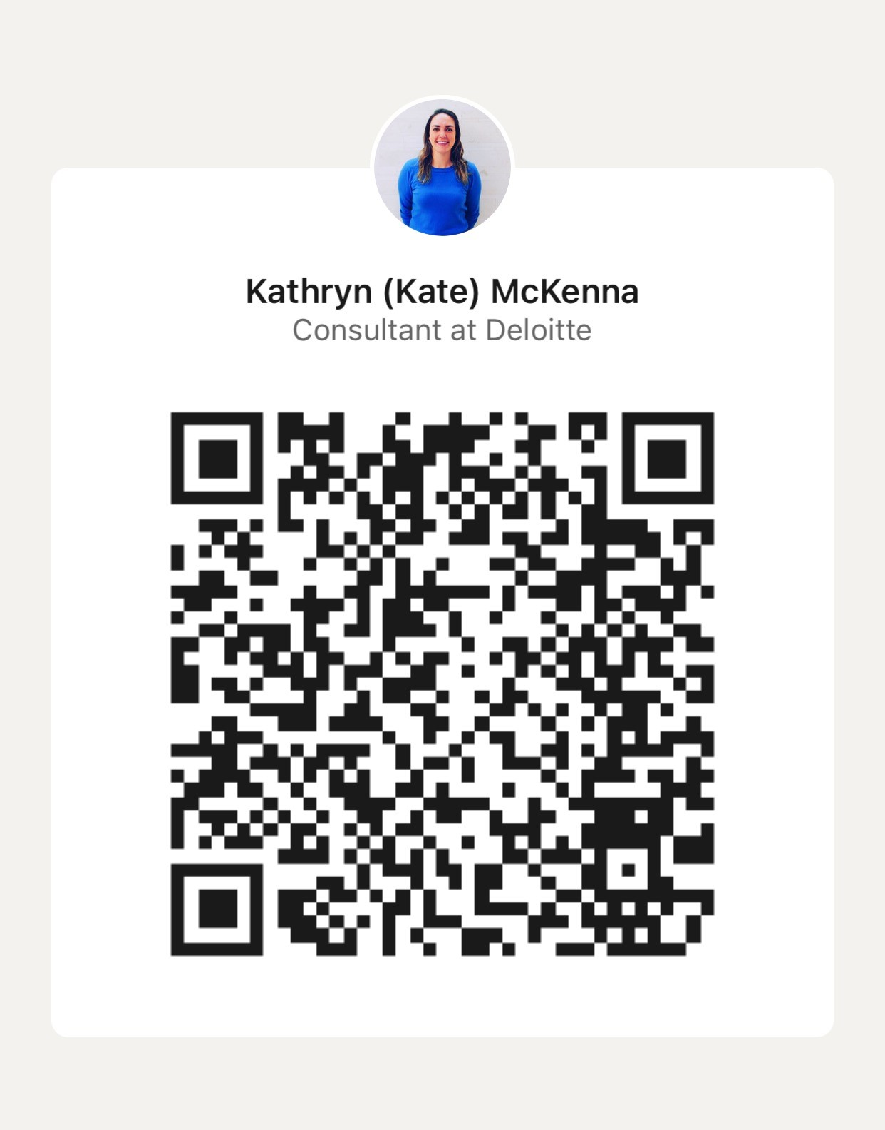
Thank you for your attention & best of luck with your remaining time at KP!
Please feel free to connect with me via LinkedIn for any follow up questions!

